Slide 1
Enhanced IEEE 802.11 by Integrating Multiuser Dynamic OFDMA
Hasan Shahid Ferdous
Supervised by
A/Prof. Manzur Murshed

Slide 2
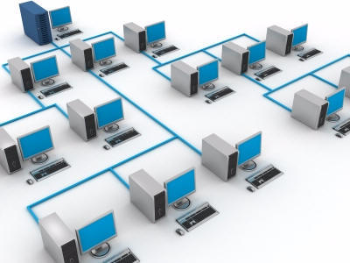
Outline
Motivation of this research
Related works
Main idea
System description
Analysis of our system
Simulation results
Future goals

Slide 3
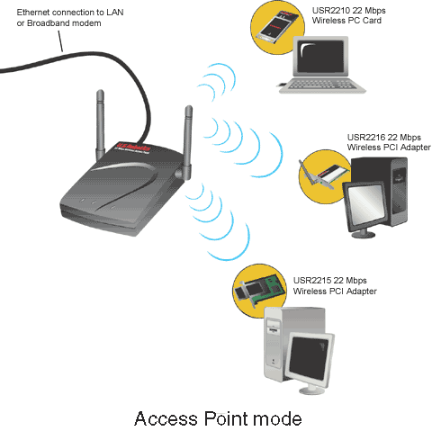
Focus of Our Work
IEEE 802.11 DCF Performance
  Access Point Based Operation
  RTS/CTS Handshaking Protocol.
The reasons of DCF inefficiency.
A solution based on OFDMA
  Incorporate multiple concurrent transmissions/receptions.
  Improve performance.

Slide 4
Throughput of IEEE 802.11
802.11 Protocol | Release | Freq. (GHz) | Typ. throughput (Mbps) | Max net bitrate (Mbps) | Modulation
IR/FSSS | Jun 1997 | 2.4 | < 1 | 2 | DSSS
a | Sep 1999 | 5 | 23 | 54 | OFDM
b | Sep 1999 | 2.4 | 5 | 11 | DSSS
g | Jun 2003 | 2.4 | 20 | 54 | OFDM
y | Nov 2008 | 3.7 | 23 | 54 | OFDM
n | Nov 2009 | 2.4/5 | 75 | 288.9 | OFDM
Wireless Networking in the Developing World (2nd Edition) pp. 290

Slide 5
Performance Analysis of the IEEE 802.11 Distributed Coordination Function
G. Bianchi, IEEE Journal on Selected Areas of Communication, Mar. 2000.
IEEE 802.11a, Saturation load, packet size = 1024 bytes

Slide 6
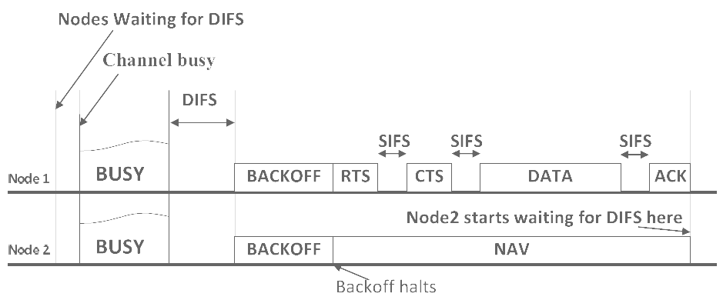
Wasted Time due to DCF
RTS, CTS and ACK are sent in the lowest data rate.
  Wasted time = DIFS + Back off + RTS + SIFS + CTS + SIFS + SIFS + ACK
  = Back off + 123 µs (per successful transmission)
Collision causes waste of time and increases back off window exponentially.
  Wasted time = DIFS + Back off + RTS + SIFS + CTS + Retry
  = Back off + 84 µs (for one collision) + Retry
Frame type | Packet size (B) | Data Rate (Mbps) | Time Required(us)
RTS | 20 | 6 | 26.67
CTS | 14 | 6 | 18.67
ACK | 14 | 6 | 18.67
MAC Frame | 1024 | 12 | 682.67
MAC Frame | 1024 | 18 | 455.11
MAC Frame | 1024 | 24 | 341.33
MAC Frame | 1024 | 36 | 227.55
MAC Frame | 1024 | 48 | 170.67
MAC Frame | 1024 | 54 | 151.70

Slide 7

Performance of DCF
So, we can conclude that DCF is not as efficient as it should be.
Major reasons for its inefficiency are
  Waste of bandwidth in Inter frame spaces, RTS, CTS, and back off.
  Collision in RTS transmissions.
Solution:
  Divide the nodes into groups.
  Incorporate multiple concurrent transmissions/receptions using OFDMA

Slide 8
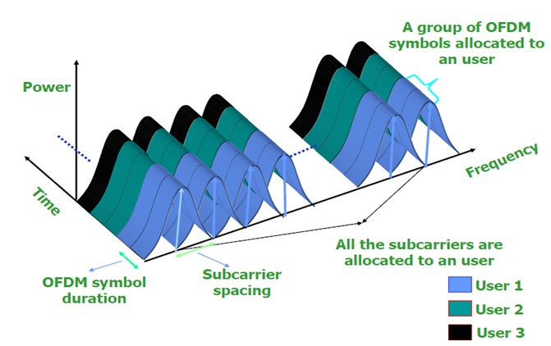
Medium access using OFDM-TDMA

Slide 9
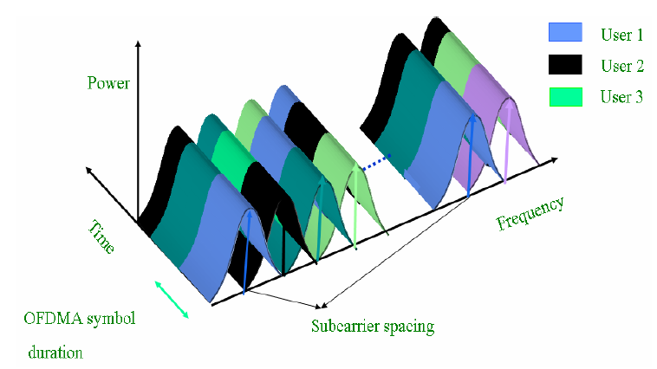
Orthogonal Frequency Division Multiple Access (OFDMA)

Slide 10

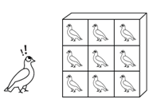
Basic Idea: Birthday Problem
The birthday problem pertains to the probability that in a set of randomly chosen people, some pair of them will have the same birthday.
In a group of 23 randomly chosen people, there is more than 50% probability that some pair of them will have the same birthday.
For 57 or more people, the probability is more than 99%, and it reaches 100% when the number of people reaches 367.

Slide 11

Analogy of IEEE 802.11 DCF Contention with Birthday Problem
Number of slots = Number of days
Number of nodes = Number of people
Probability of collision = ?
Divide the node into groups
Number of slots = Same
Number of nodes = Number of nodes/No of sub-channels
Probability of collision = ?

Slide 12
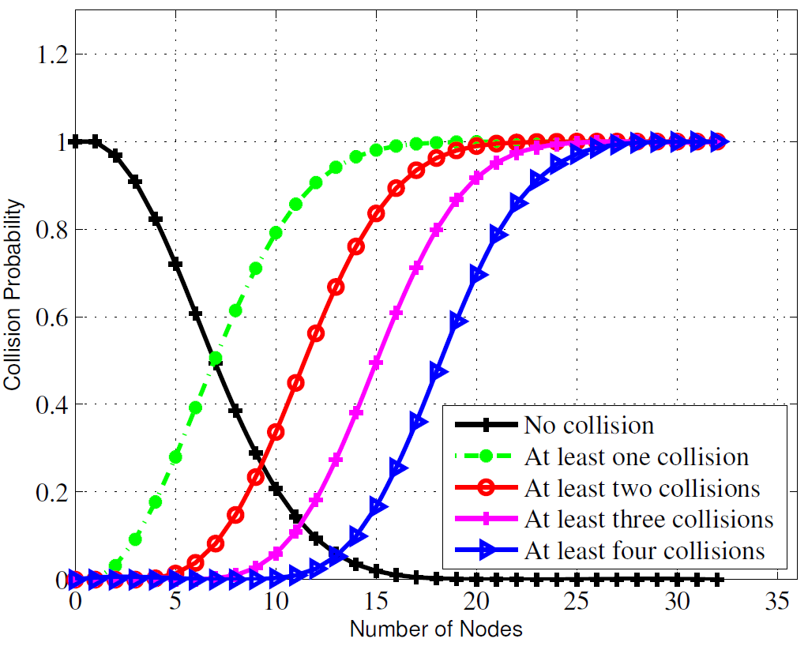
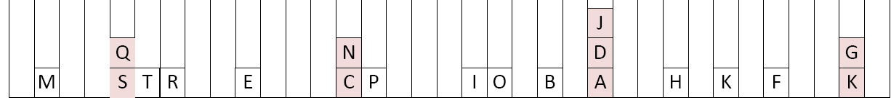
Probability of Collisions in RTS Message
_{32 Slots, 20 Nodes}

Slide 13
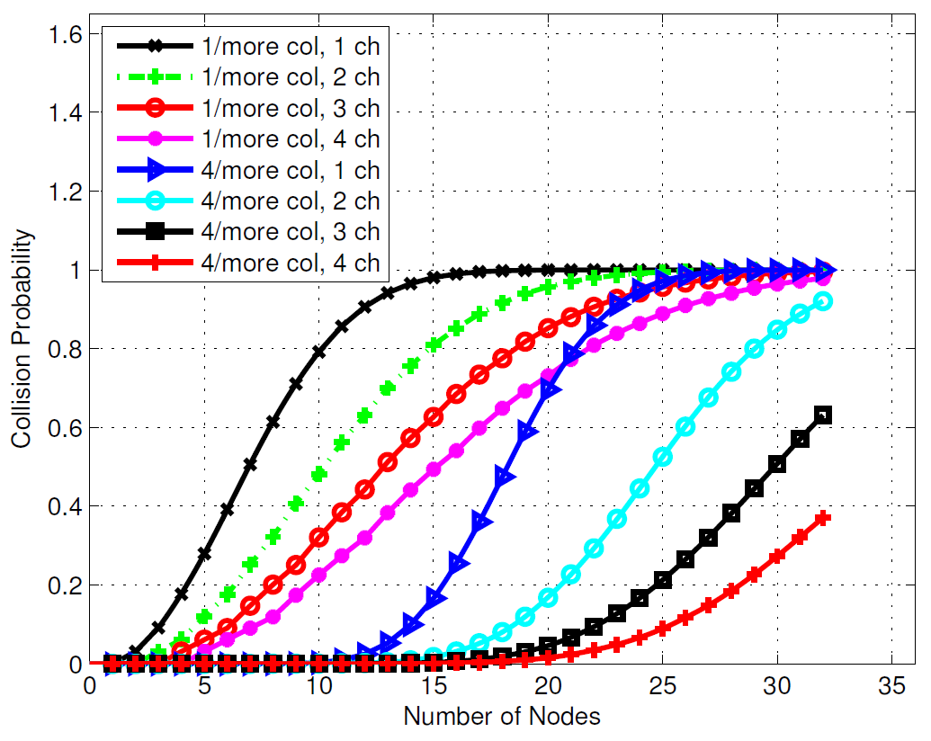
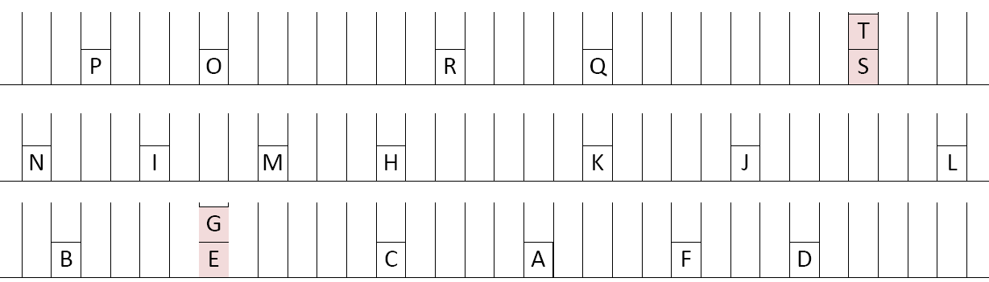
Collisions with sub-channelization
32 Slots, 3 Sub-channels, 20 Nodes

Slide 14
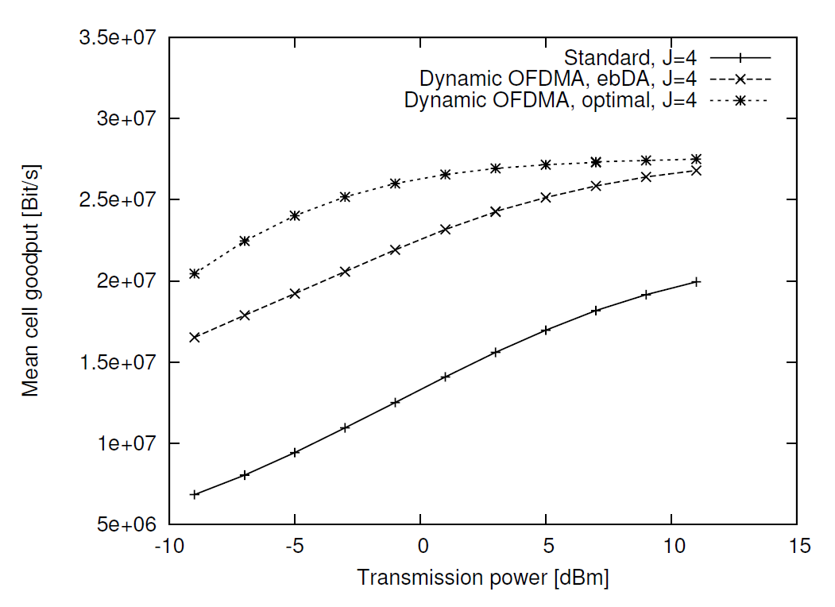
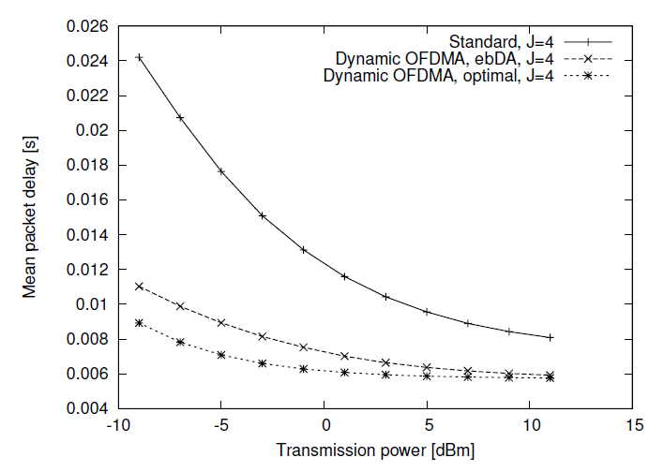
Integrating multiuser dynamic OFDMA into IEEE 802.11 WLANs – LLC/MAC extensions and system performance [ICC’08]
Pros
  One of the very few papers that describes the implementation details of OFDMA in 802.11
  Throughput increase by up to 154%
  Latency decrease by up to 63%
  Has another paper on details of the implementation
Cons
  Discusses downlink only

Slide 15

Problems with Related Works
Incorporating OFDMA in uplink is not discussed.
  In uplink, transmission is from many to one.
Cannot present a suitable method for multiple RTS exchange.
Does not focus on the delay caused by sub-channelization.
Does not provide mathematical analysis for this kind of MAC.
So, we propose a solution
  Incorporate multiple concurrent transmissions.
  Reduce DCF inefficiency.
Provide throughput and delay analysis.

Slide 16
Our System
AP determines the set of associated nodes and divides them into multiple groups.
Nodes in the same group share the same frequency sub-channel.
In every group, nodes contend among themselves to capture the channel. However, if only one node is assigned to a group, no backoff is required.

Slide 17
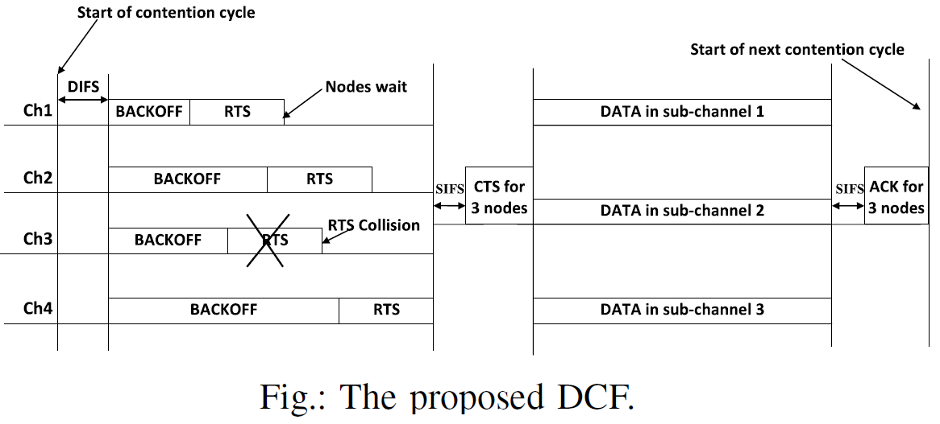
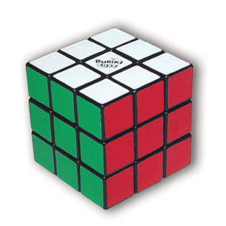
Our New DCF

Slide 18
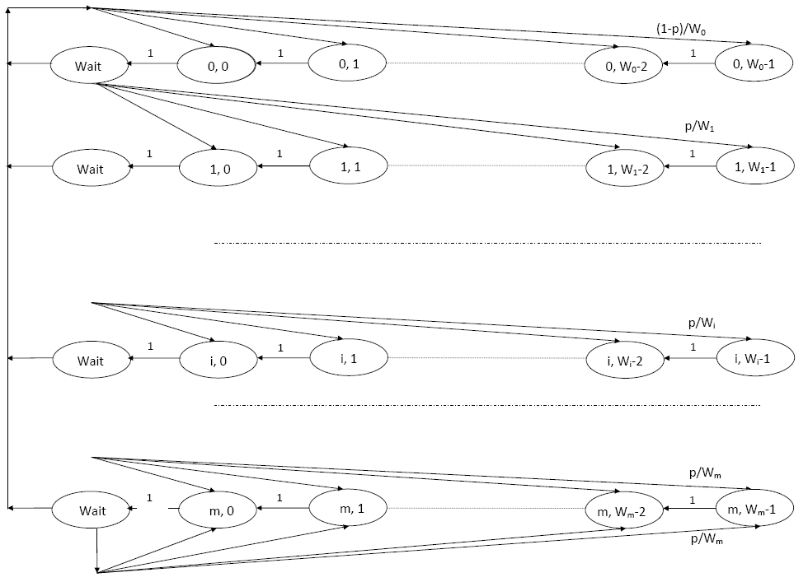
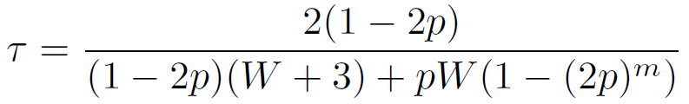

Markov Chain Model of Our DCF

Slide 19
Simulation Scenario
To analyze the impact of sub-channelization,
  we considered saturation load in this paper
  we did not consider adaptive modulation and coding (AMC)
Number of sub-channel = 2, 4, 8, 16
Number of Nodes = 2, 4, .... ..., 48
Packet size = 1024 bytes.
Simulation time = 10,00,000 µs
Number of simulations = 30
IEEE 802.11a system parameters.

Slide 20
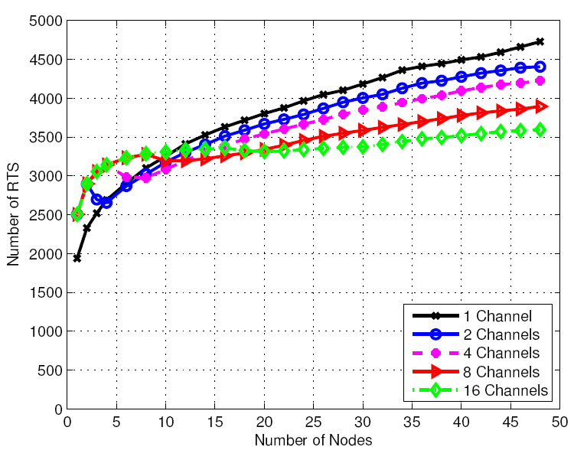
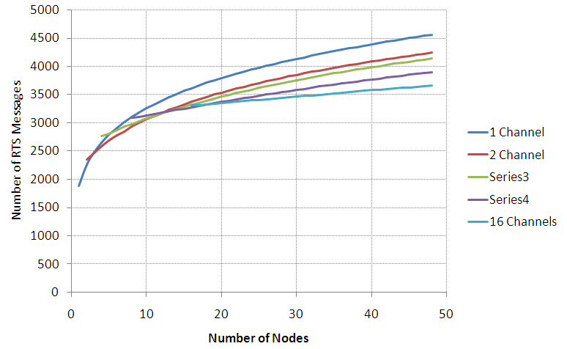
Number of RTS Messages

Slide 21
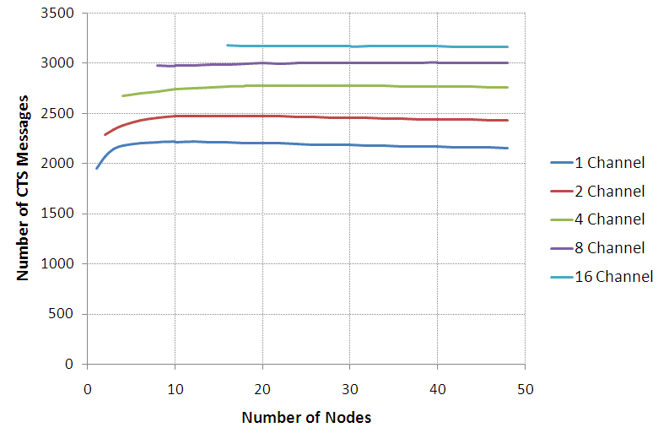
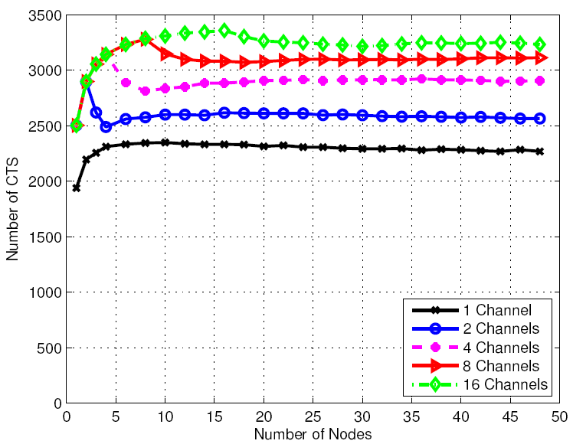
Number of CTS Messages

Slide 22
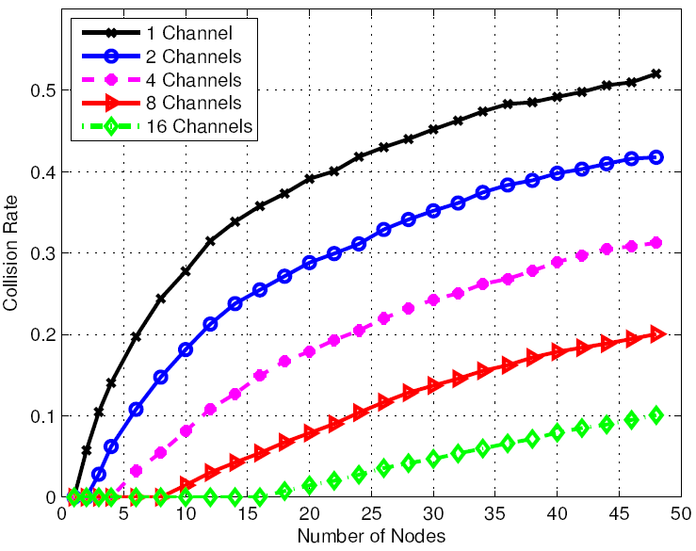
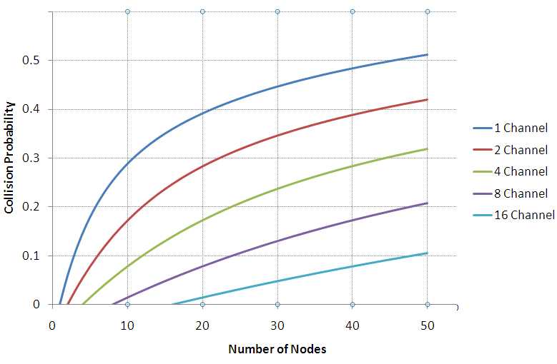
Collision Probability

Slide 23
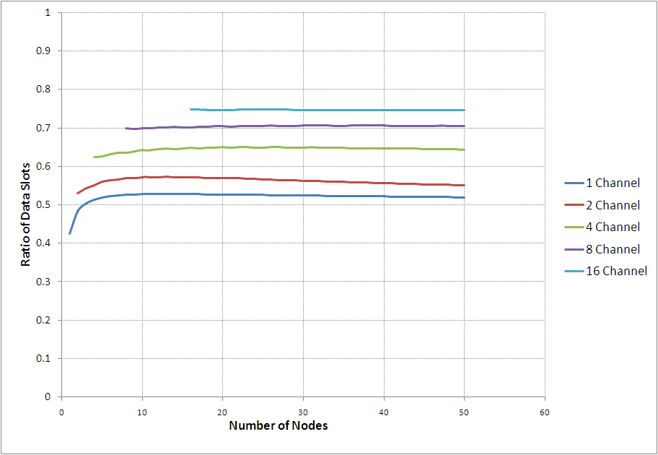
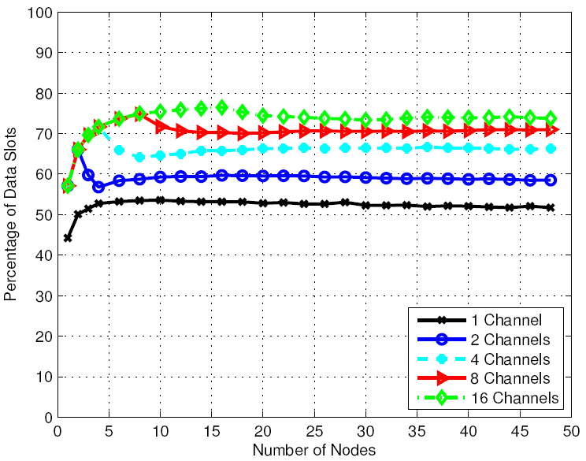
Throughput Analysis

Slide 24
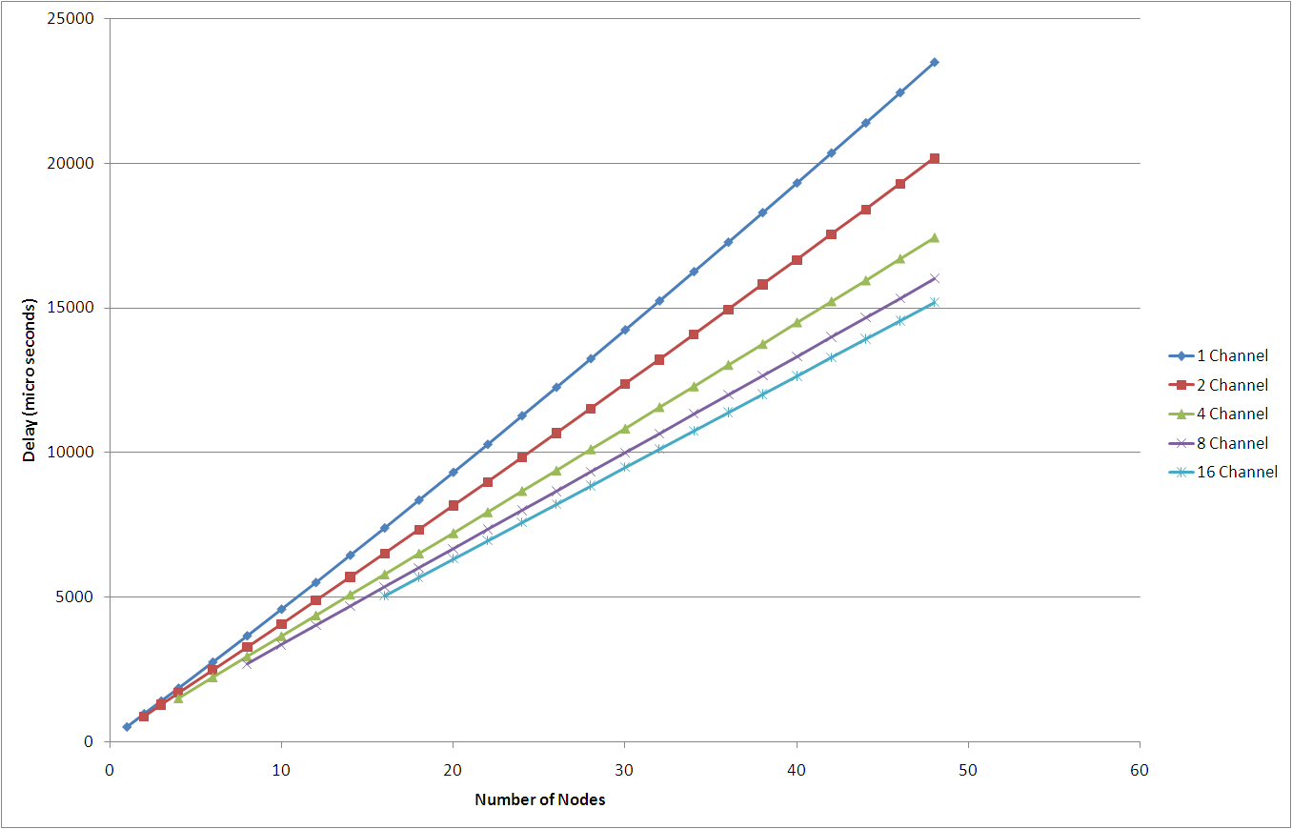
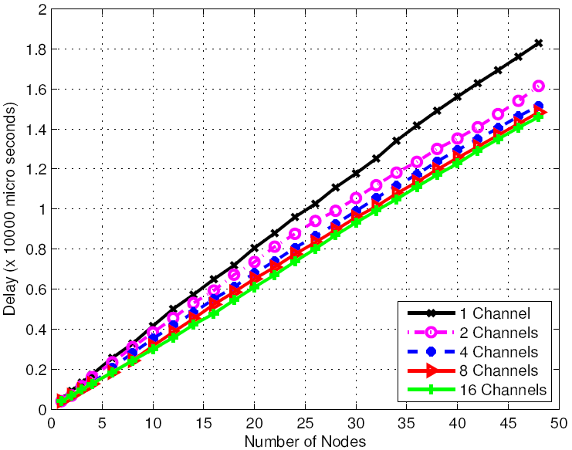
Average Delay

Slide 25
Conclusion and Future Goals
So, we can conclude that integrating OFDMA in IEEE 802.11 can substantially improve its performance.
We are now working on incorporating OFDMA for finite load conditions.
  Optimally decide the number of sub-channels.
  Analyse performance for heterogeneous nodes.

Slide 26

Thank You

