Slide 1
Analytical Modeling of Enhanced IEEE 802.11 with Multiuser Dynamic OFDMA under Saturation Load
Hasan Shahid Ferdous, Manzur Murshed
Presented By
Masumuzzaman Bhuiyan
Monash University, Australia
www.monash.edu.au
Notes:
Just Introduce the title, authors and presenter

Slide 2
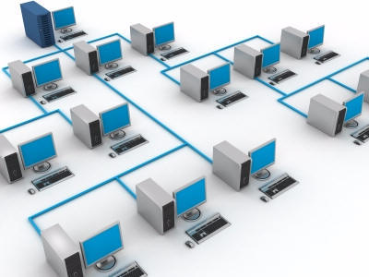
Outline
Motivation of this research
Basic idea
Related challenges
System description
Simulation results
Future goals
Notes:
Please read the list of outline

Slide 3
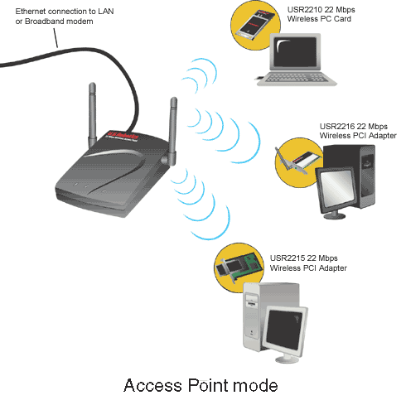
Focus of Our Work
IEEE 802.11 DCF Performance
  RTS/CTS Handshaking Protocol.
  AP Based Operations
The reasons of DCF inefficiency.
A solution based on OFDMA
  Incorporate multiple concurrent transmissions/receptions.
  Improve performance.
Notes:
In this paper, we have focused on improving the performance of IEEE 802.11 DCF based local area networks. We discuss the reasons of its DCF inefficiency and propose a solution based on OFDMA. Our proposed protocol improves the performance by incorporating multiple concurrent transmissions/receptions.

Slide 4
Throughput of IEEE 802.11
802.11 Protocol | Release | Freq. (GHz) | Typ. throughput (Mbps) | Max net bitrate (Mbps) | Modulation
IR/FSSS | Jun 1997 | 2.4 | < 1 | 2 | DSSS
a | Sep 1999 | 5 | 23 | 54 | OFDM
b | Sep 1999 | 2.4 | 5 | 11 | DSSS
g | Jun 2003 | 2.4 | 20 | 54 | OFDM
y | Nov 2008 | 3.7 | 23 | 54 | OFDM
n | Nov 2009 | 2.4/5 | 75 | 288.9 | OFDM
Wireless Networking in the Developing World (2nd Edition) pp. 290
Notes:
There have been lot of research works in the DCF performance. If we look at the performance of IEEE 802.11 networks, we can see that the practical achievable throughput is less than half of its theoretical capacity. This data is supported by the research works of Bianchi and many other researchers.

Slide 5

Performance of DCF
DCF is not efficient.
Major reasons for its inefficiency are
  Wastage of bandwidth in
    Backoff and IFS,
    Control Messages
  Collisions in RTS transmissions.
Solution:
  Divide the nodes into groups.
  Incorporate multiple concurrent transmissions/receptions.
Notes:
In our previous paper, we have shown that the principle reason for DCF inefficiency is wastage of the available bandwidth in backoff and inter frame spacing times. We have shown that as the number of devices increases, collisions increases very rapidly and play a major role in DCF performance.
In our previous paper, we proposed a solution by dividing the nodes into multiple disjoint groups and using OFDMA techniques to incorporate multiple concurrent transmissions/receptions.

Slide 6
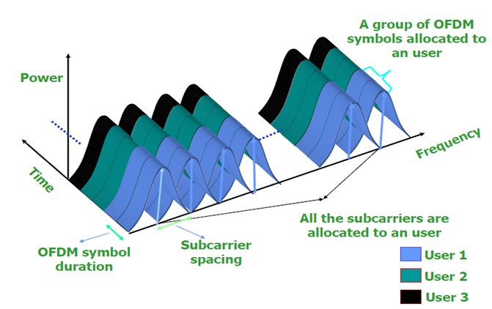
Medium access using OFDM-TDMA
Notes:
Traditional 802.11 devices use OFDM and share the medium in a TDMA fashion. All the subcarriers in the available bandwidth is used by one station at a particular time.

Slide 7
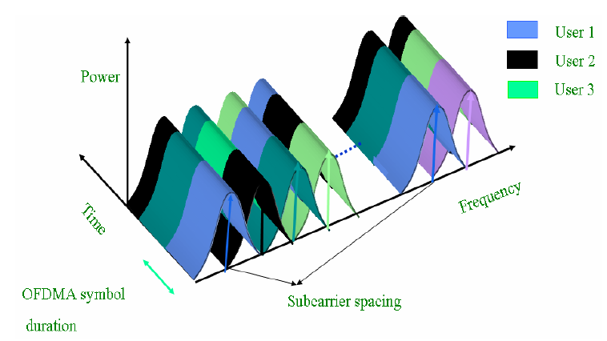
Orthogonal Frequency Division Multiple Access (OFDMA)
Notes:
But using OFDMA, we can share the medium in both time and frequency domain. Here a group of subcarriers, called sub-channel is assigned to a node, and multiple device can use the spectrum at the same time.

Slide 8
Enhanced IEEE 802.11 by Integrating Multiuser
Dynamic OFDMA [WTS 2010]
Pros
  A complete OFDMA based DCF for access point based operations of IEEE 802.11
  Collision decrease by up to 80%
  Throughput increase by up to 50%
  Latency decrease by up to 30%
Cons
  Simulation Results Only. No theoretical analysis/proof
  Only for AP based operations
Notes:
Based on OFDMA, we have proposed a DCF for access point based operations of IEEE 802.11. This work is presented and published in 9th Annual Wireless Telecommunications symposium. In that work, we have shown that our proposed protocol can improve the performance substantially. We achieved a throughput improvement of up to 50% by reducing collisions up to 80% and decreasing delay by up to 30%.
Multiuser dynamic OFDMA based IEEE 802.11 distributed coordination function (DCF) has received significant interest from the researchers in recent time. Though several
proposals have been made, to the best of our knowledge, none of these have presented an analytical model for this kind of medium access control protocols for IEEE 802.11. This paper provides a simple, nevertheless, very accurate analytical model to estimate the performance characteristics of IEEE 802.11 DCF
with OFDMA under the assumptions of ideal channel conditions and saturation load.

Slide 9
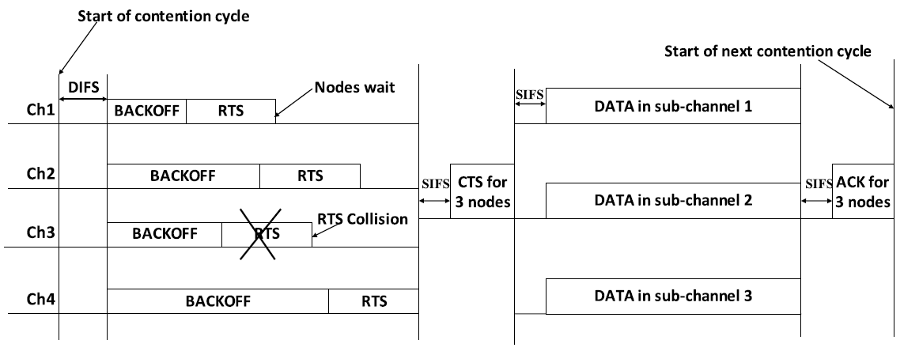
Our New DCF
Notes:
This figure illustrates the operation of our proposed DCF, where there are four sub-channels and devices are contending to access them.

Slide 10
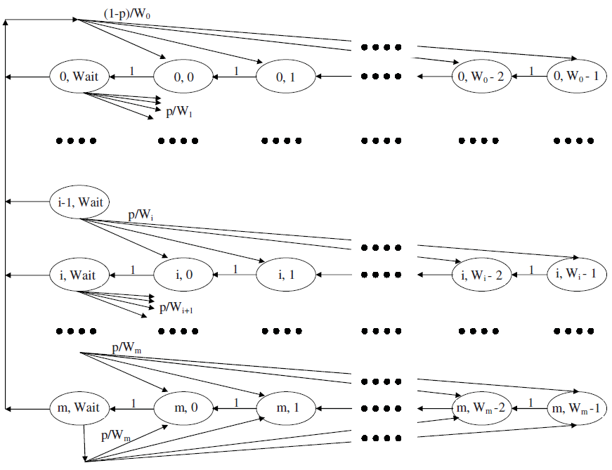
A Markov Chain Model of Our Proposed DCF
Notes:
Our proposed Markov chain model resembles with the famous one proposed by Bianchi, but we needed to incorporate the WAIT STATE at each of the retry levels.
We have developed a complete analysis of this chain, solving it to find the transmission probability by each node at each state and the collision probability given a transmission happened. Then based on this analysis we formulated equations to estimate the performance parameters. Our model accounts for important system
parameters like throughput, collision rate, transmission delay, average contention window size, average retry count and average time wasted in backoff. Analytical results are verified through extensive simulations.
To analyze the impact of sub-channelization we assumed perfect channel conditions so that we can consider only the impact of our modifications. We did not use adaptive modulation and coding (AMC).
We do not go into mathematical descriptions in this talk. Please go through the paper and contact the authors if necessary.

Slide 11
Simulation Scenario
Number of sub-channel = 2, 4, 8, 16
Number of Nodes = 2, 4, .... ..., 50
Packet size = 1024 bytes.
Simulation time = 10s
Number of simulation runs = 100
IEEE 802.11a/g system parameters.
SimJava based event driven simulation
Notes:
To analyze the performance of our proposed DCF, we developed a discrete event driven simulation using SimJava2 and examined every aspect of our system. We assumed perfect channel conditions so that we can consider only the impact of our modifications. We tried to remain close to the IEEE 802.11 a/g protocol. We did not use adaptive modulation and coding (AMC); rather we used fixed data rate of 36 Mbps to simulate both traditional IEEE 802.11 and our proposed system. We varied the number of nodes from 1 to 50 and experimented with 2, 4, 8, and 16 sub-channels to examine the performance of our proposed system.
We will now show a few important results. The analytical results are shown using dotted lines of the same color as simulation results. For full details, please refer to our paper.

Slide 12
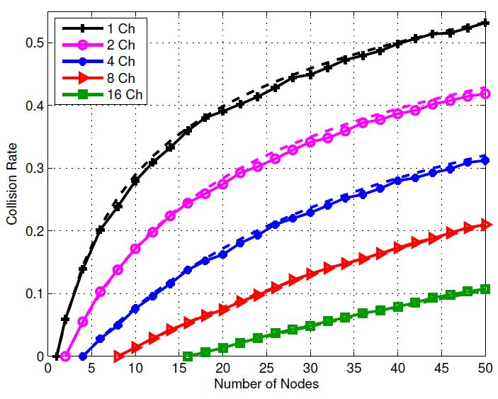
RTS Collision Rate
Notes:
Let us consider the percentage of RTS messages that are lost due to collisions first. We can see that collisions in standard IEEE 802.11 DCF increase very quickly as the number of devices increases and it can reach up to 53% with 50 nodes present in the system. Introducing sub channelization can effectively decrease collisions by up to 80% and save available transmission time and power.

Slide 13
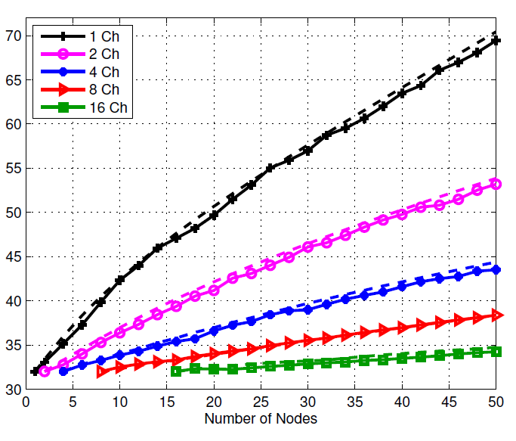
Average Contention Window Size
Notes:
Collisions have further impact on contention window size, which is doubled each time
a collision occurs, until it reaches its maximum. In traditional IEEE 802.11, we can see that the average contention window size is much higher than our proposed protocol. The impact of collisions is also reflected in the average number of transmissions that a node needs to make in order to transmit a packet successfully. In our proposed DCF,
we need much less retransmissions and thus save transmission power and time.

Slide 14
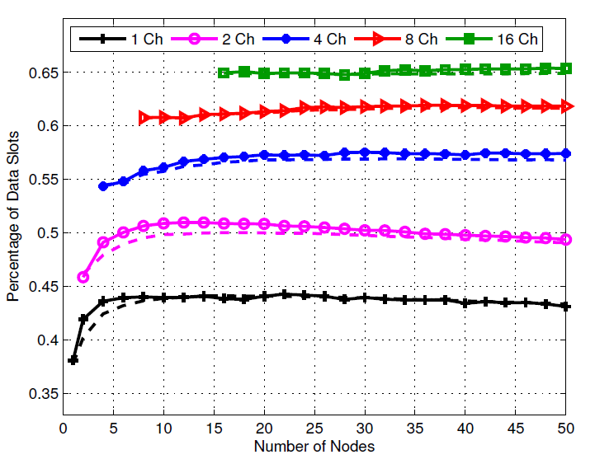
Data Throughput
Notes:
Now the most important performance criteria – the throughput.
This figure shows about the percentage of time slots carrying payload data, which is another way of calculating throughput. We can see that traditional IEEE 802.11 DCF uses the channel to carry payload data for only 43% of the total time on an average, whereas we can reach up to 65% using our proposed DCF for AP based operations.

Slide 15
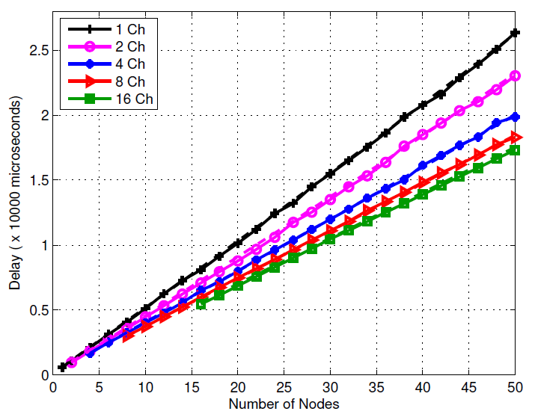
Average Packet Transmission Delay
Notes:
As our final performance measure, we consider average delay of packet transmission in this figure. Delay is measured from the time a packet is in the head of queue of its corresponding device to the time it is successfully transmitted, including retransmissions. We can see that the benefits of our proposed DCF overcomes the protocol overhead and delay is decreased by up to 30 percent.

Slide 16
Summary and Future Goals
Integrating OFDMA in IEEE 802.11 can substantially improve its performance.
This paper provides a rigorous analysis of our proposed system for AP based operations.
We are now working on incorporating OFDMA for finite load conditions.
  Optimally decide the number of sub-channels.
  Analyse performance for heterogeneous nodes.
Notes:
In this paper, we have presented a simple analytical model to evaluate the saturation performance of a sub-channelized DCF for IEEE 802.11. Comparison with simulation results shows that the model is extremely accurate in predicting the system's performance metrics. We have demonstrated that dividing the nodes into discrete groups and allowing multiple concurrent transmissions can significantly reduce collisions in IEEE 802.11 DCF and improve the performance of the wireless LAN. We are now working to model the system for imperfect channel conditions and non-saturation load. In that context, determining the optimal number of sub-channels and efficiently allocating nodes to them remain as a major research challenge.

Slide 17

Thank You
Author’s email adress
webtonmoy@yahoo.com

