Slide 1

Statistical Analysis and Implications of SNS Search in Under-Developed Countries
Presented by
Hasan Shahid Ferdous
MPhil leading to PhD Student,
Dept. of Computing and Information Science,
University of Melbourne, Australia

Slide 2


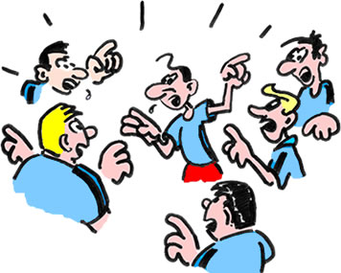

Searching Before the Digital Era

Slide 3

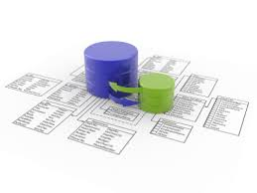

Using the Search Engines (SE)
Hasan Shahid Ferdous, OzCHI 2013

Slide 4





Use the Social Network for Search?

Slide 5
Use the Social Network for Search?
Is SNS important as an information source?
  Yes!
What about
  Accuracy of information
  Motivation for answering
  Response rate of queries
  Many more issues ….
Is it same in every culture, society, or country??
Hasan Shahid Ferdous, OzCHI 2013

Slide 6
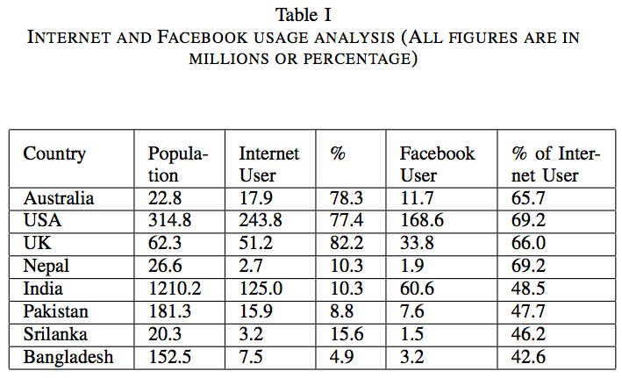
Hasan Shahid Ferdous, OzCHI 2013

Slide 7
Research Methodology
Facebook as an example SNS
Background data collection and analysis
Compared with Morris et. al. [1]
Face to face interviews, focussed discussion group, Skype
Survey through questionnaire and analysis
Hasan Shahid Ferdous, OzCHI 2013

Slide 8
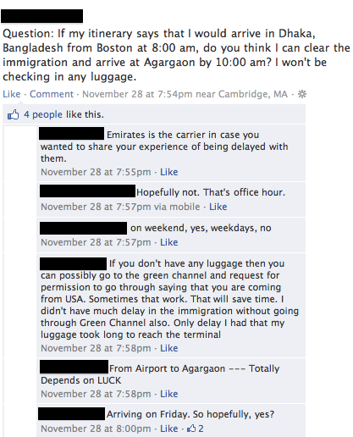
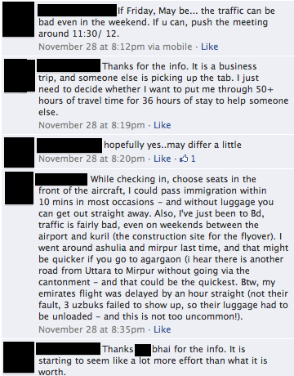
New Insight from SNS?
“In my case, I got a suggestion that I possibly would have never thought about, and that is the beauty of human collaboration”

Slide 9
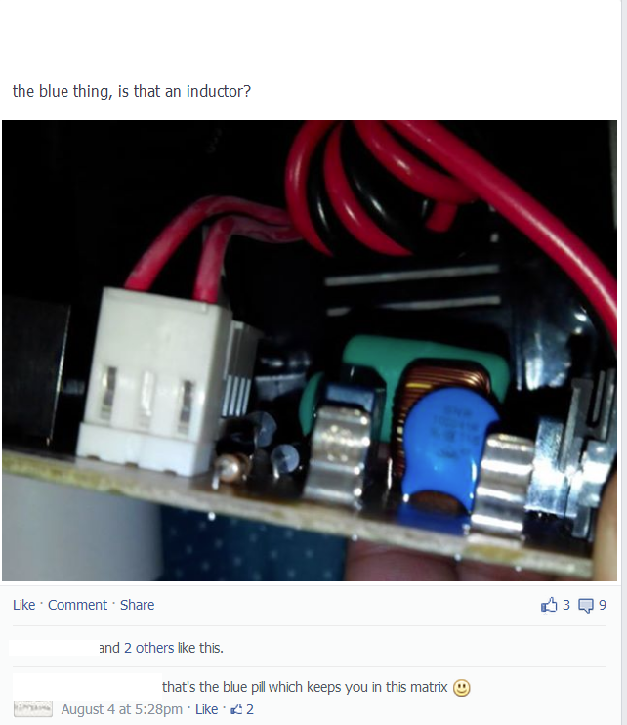
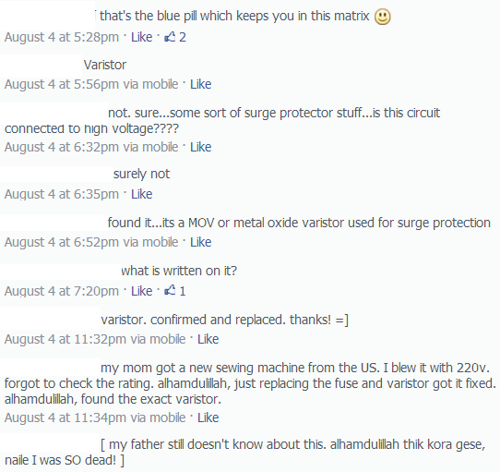
Diversity of Topics (and Answers)
“I was badly looking for the answer, yet the first reply got me off-guard, and I could hardly stop laughing..”

Slide 10
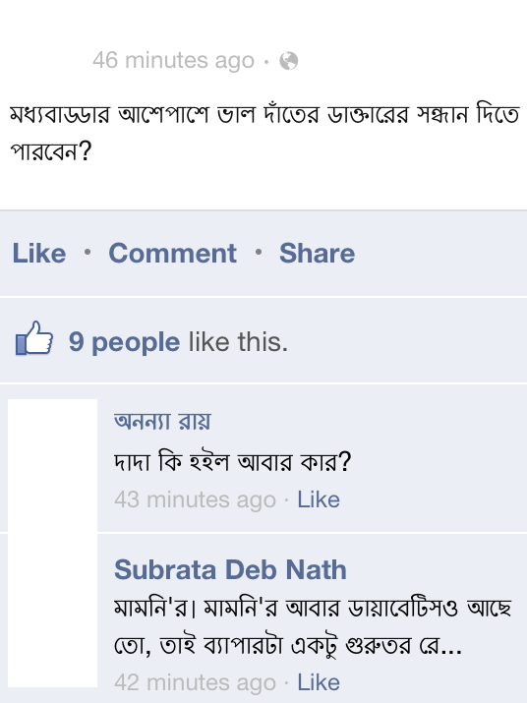
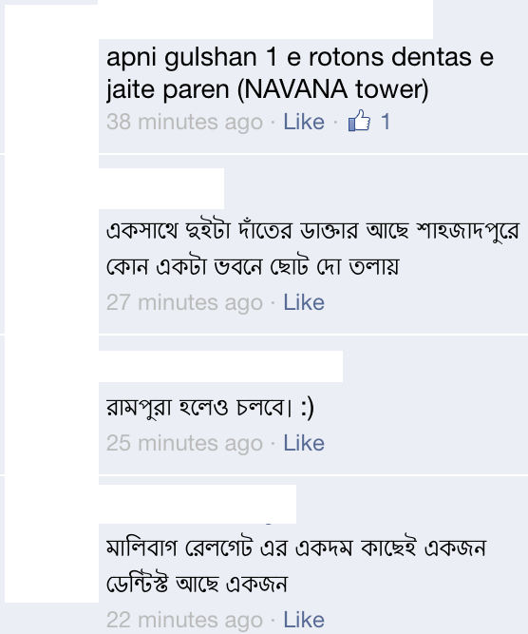
Diversity of Topics
“People I know are so supportive and caring; not only I got the answer to my query, many of my friends later inquired about the wellbeing of my mother.”

Slide 11
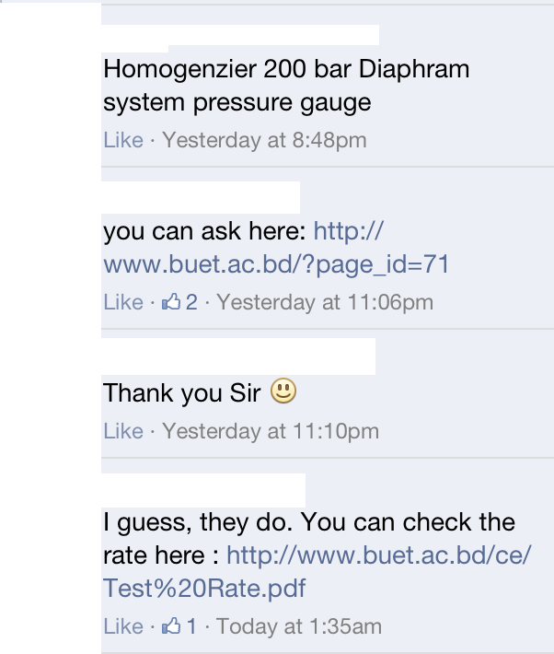
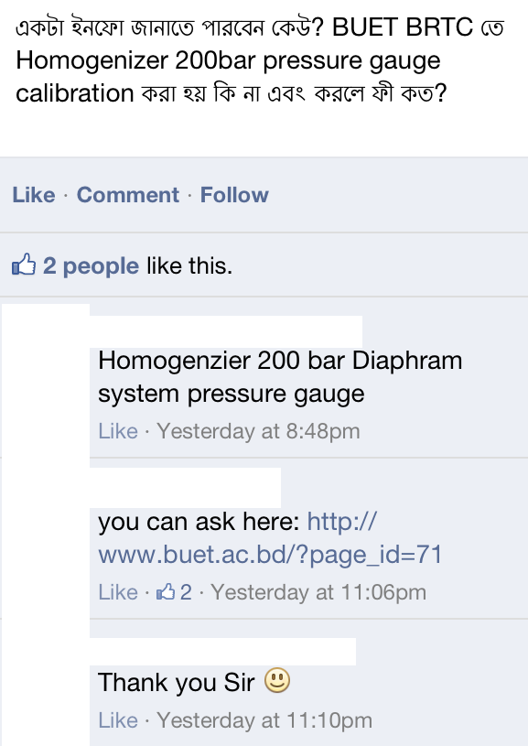
Social Gap??
“I got the answer, probably with a warning to Google it before I ask the community. But it was from my teacher, you know..”

Slide 12
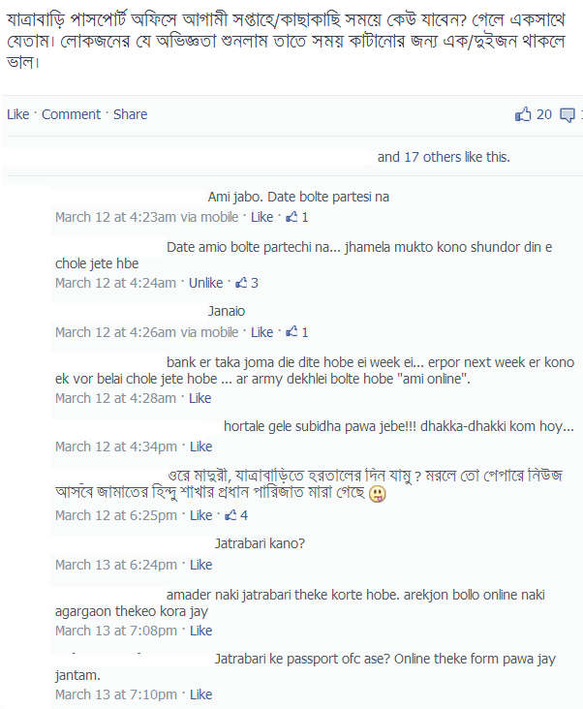
May Result in Unexpected Discussion
“The discussion went to a different direction…but enjoyable anyways..”

Slide 13
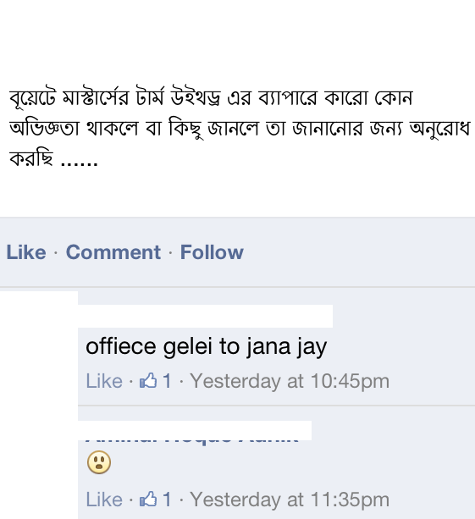
Not Everyone is Helpful

Slide 14
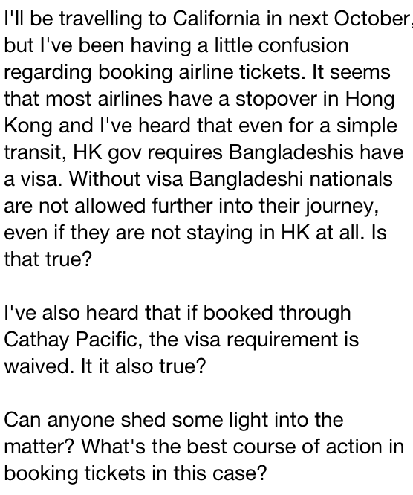
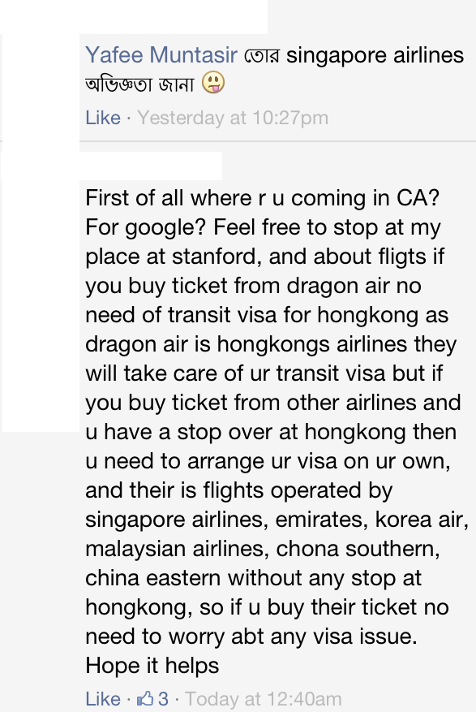
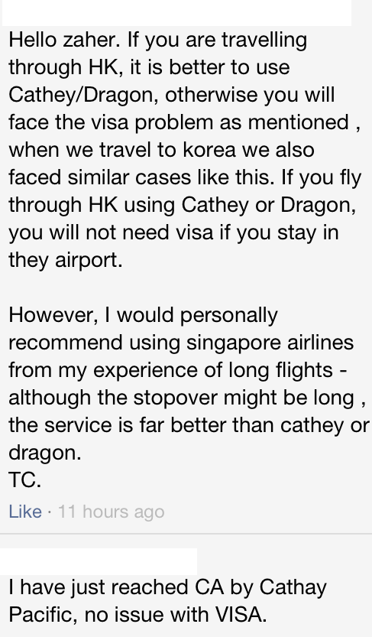
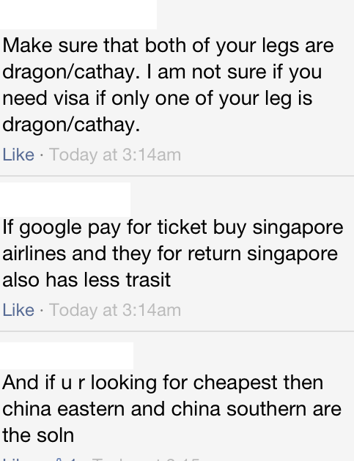
All the explanations.. It was really helpful.. I was confused about the descriptions provided in their website..

Slide 15
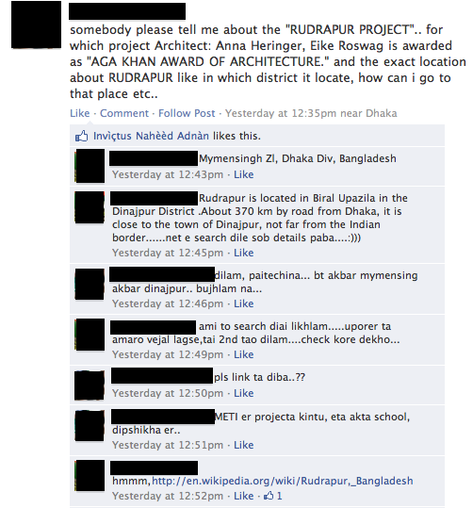
Someone may not be Adept in Searching, but..

Slide 16
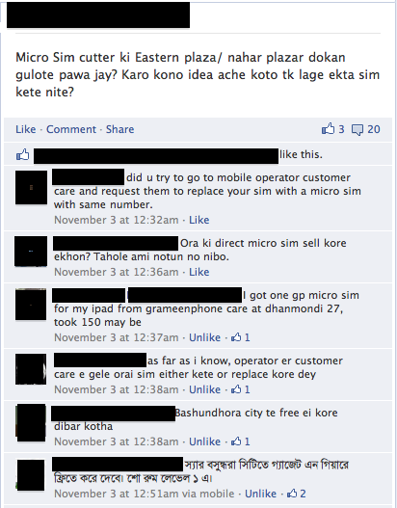
The Discussion may be Worth…
“I got a solution easier than I though about.. It was free!”

Slide 17
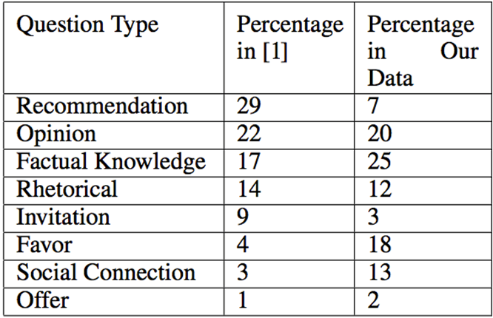
Comparison in Question Type
Hasan Shahid Ferdous, OzCHI 2013

Slide 18
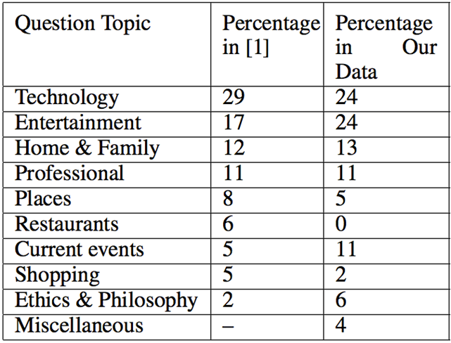
Comparison in Question Topic
Hasan Shahid Ferdous, OzCHI 2013

Slide 19
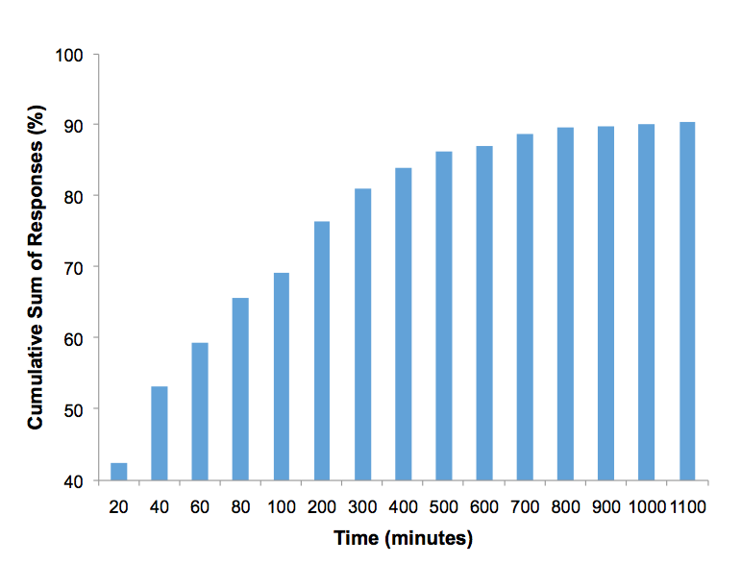
First Response Time
Hasan Shahid Ferdous, OzCHI 2013

Slide 20
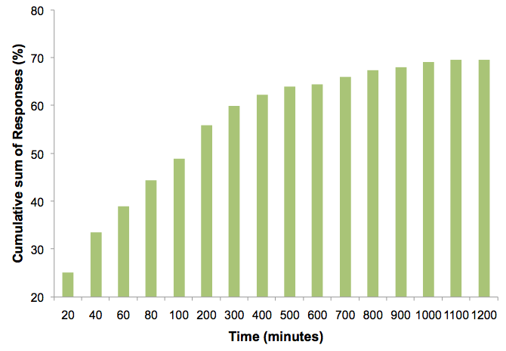
Reasonable Response Time
Hasan Shahid Ferdous, OzCHI 2013

Slide 21
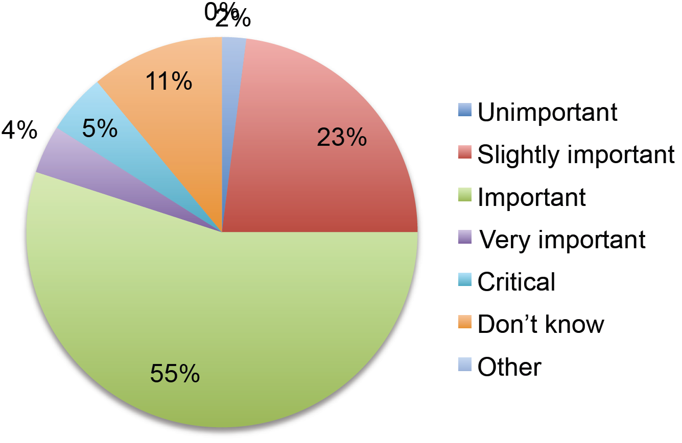
Value of Responses Obtained
Hasan Shahid Ferdous, OzCHI 2013

Slide 22
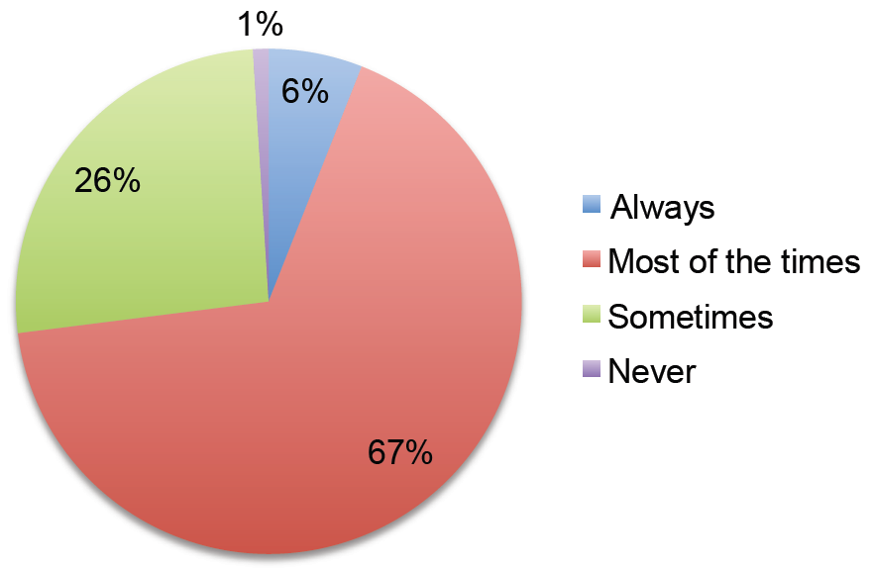
Ratio of Satisfactory Response
Hasan Shahid Ferdous, OzCHI 2013

Slide 23
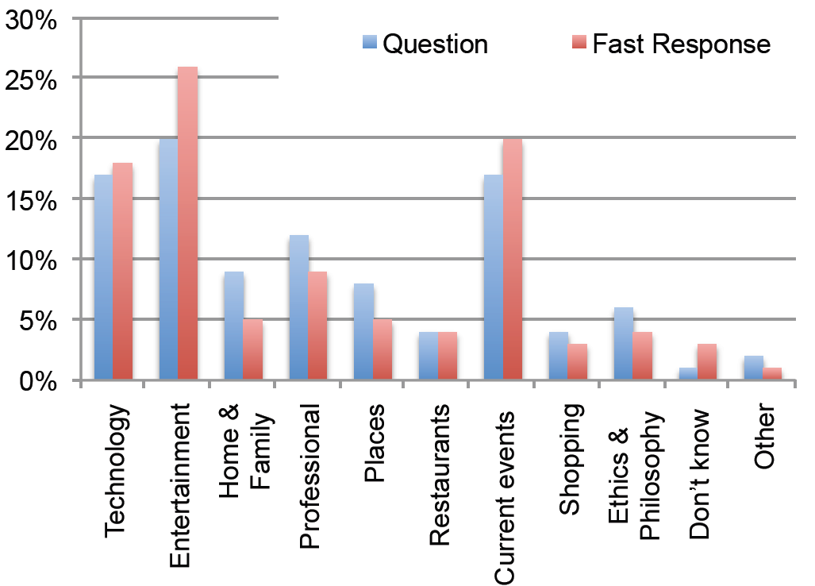
Question and Fast Response vs. Topic
Hasan Shahid Ferdous, OzCHI 2013

Slide 24
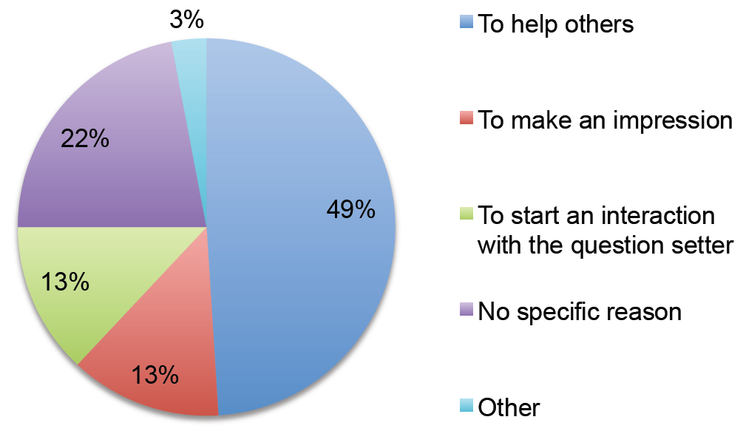
Motivation behind Responding
Hasan Shahid Ferdous, OzCHI 2013

Slide 25
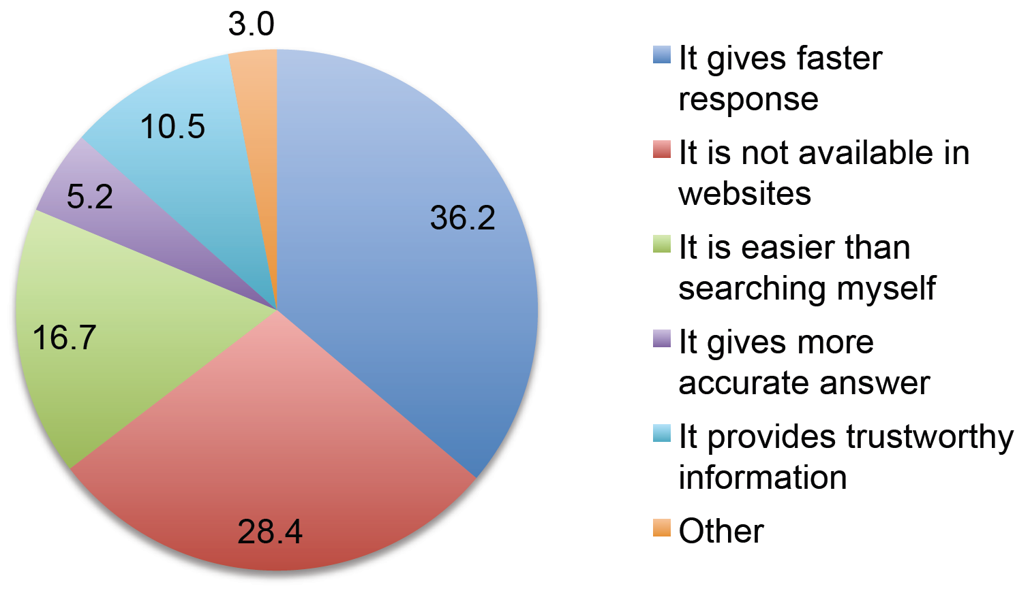
Why Use SNS Q/A
Hasan Shahid Ferdous, OzCHI 2013

Slide 26
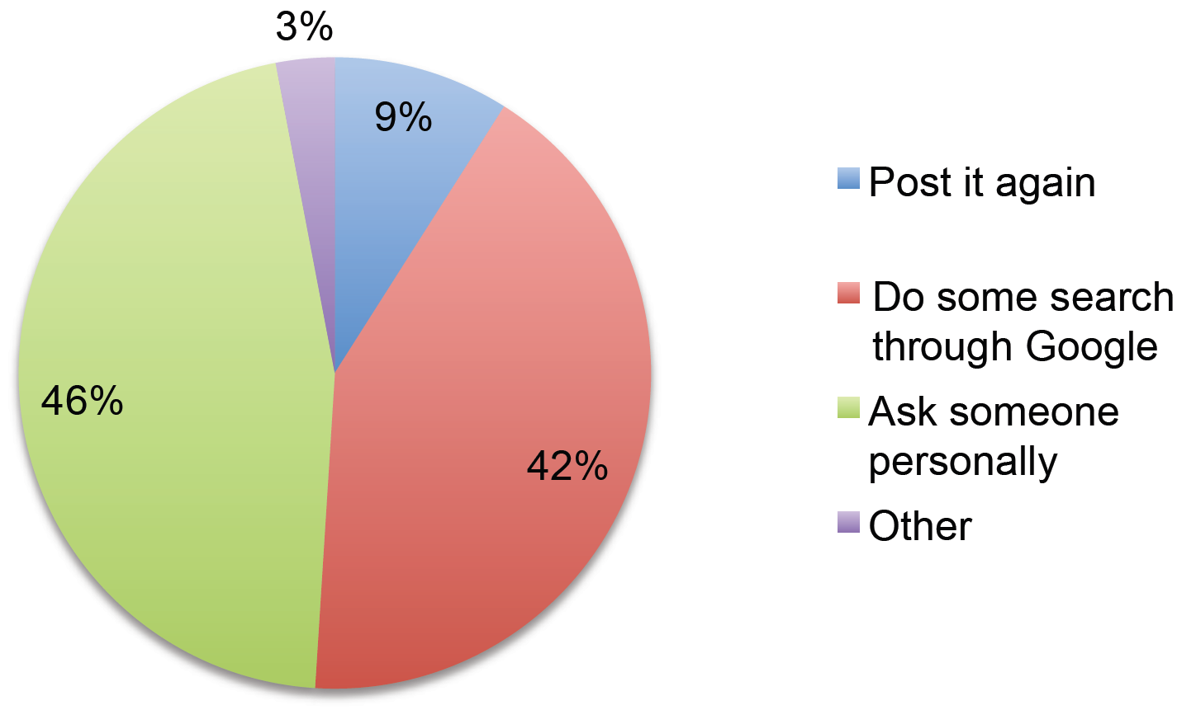
When No Satisfactory Response
Hasan Shahid Ferdous, OzCHI 2013

Slide 27
Some Key Observations
Among our participants, First response time and reasonable response time were independent of gender
People who have used Facebook for more than two years have considered to use ‘both Facebook and Google, depending on the query’ more than any other sample populations
The length of Facebook usage or the number of friends has no impact on the topics of their posted questions
More friends mean quicker first response
The reasonable response time is independent of the number of Facebook friends
Those who have more friends, prefer to use ‘both Facebook and Google’ as an information source more than the other sample groups

Slide 28
References
[1] Morris, M. R., Teevan, J., and Panovich, K. What do people ask their social networks, and why?: a survey study of status message Q&A behavior, CHI’10
[2] Efron, M., and Winget, M. Questions are content: a taxonomy of questions in a microblogging environment, ASIS&T’10
[3] Lampe, C., Ellison, N. B., and Steinfield, C. Changes in use and perception of Facebook, CSCW’08
[4] Lampe, C., Vitak, J., Gray, R., and Ellison, N. Perceptions of Facebook’s value as an information source, CHI’12
[5] Morris, M. R., Teevan, J., and Panovich, K. A comparison of information seeking using search engines and social networks, ICWSM’10
[6] Teevan, J., Morris, M. R., and Panovich, K. Factors affecting response quantity, quality, and speed for questions asked via social network status messages, ICWSM’11
[7] Teevan, J., Ramage, D., and Morris, M. R.#twittersearch: a comparison of microblog search and web search, WSDM ’11,
[8] Yang, J., Morris, M. R., Teevan, J., Adamic, L. A., and Ackerman, M. S. Culture matters: A survey study of social q&a behavior, ICWSM’11
Hasan Shahid Ferdous, OzCHI 2013

Slide 29

Thank You
hferdous@student.unimelb.edu.au

Slide 30
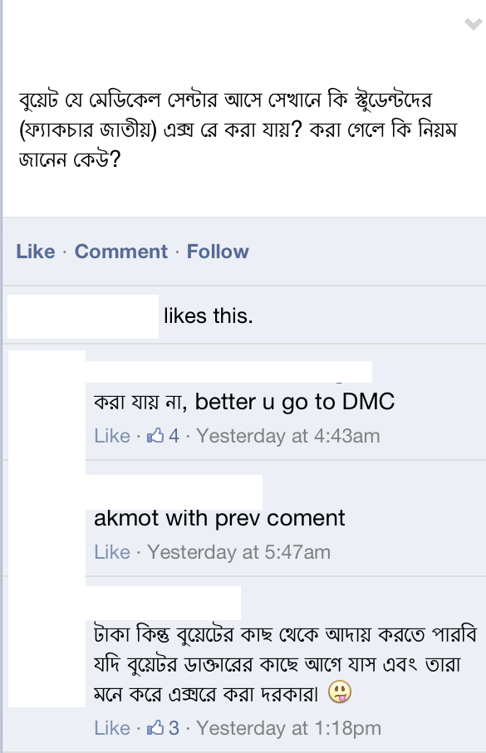
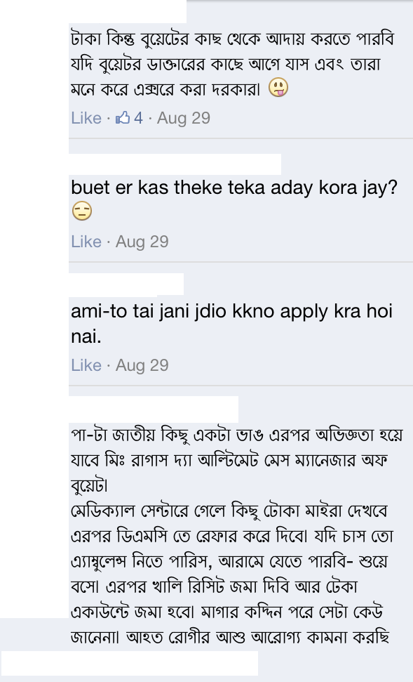
Source of Additional Information

