Slide 1

Protibadi: A Platform for Fighting Sexual Harassment in Urban Bangladesh
Syed Ishtiaque Ahmed (Cornell University, USA)
Steven J. Jackson (Cornell University, USA)
Hasan Shahid Ferdous (BUET, Bangladesh)
Md. Rashidujjaman Rifat (BUET, Bangladesh)
ASM Rizvi (BUET, Bangladesh)
Shamir Ahmed (BUET, Bangladesh)
Rifat Sabbir Mansur (BUET, Bangladesh)
Nova Ahmed (NSU, Bangladesh)
Photo collected from Flickr

Slide 2
Organization
The problem of public sexual harassment in urban Bangladesh
Filed Study
  Data Collection: Online Survey
  Data Collection: Focus Group Discussion
  Data Collection: One-on-one Interviews
Design and Development
  Software Development and Deployment
  User Feedback
Discussion and Future Directions

Slide 3



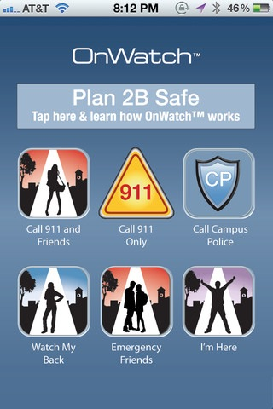
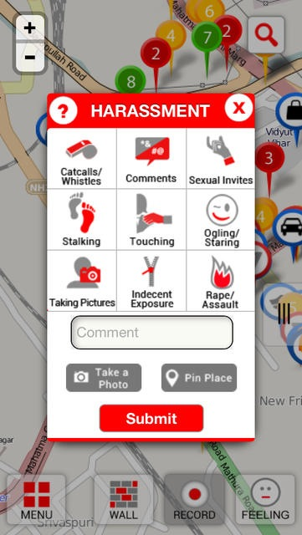



Some Available Technologies

Slide 4
The problem of public sexual harassment in Bangladesh
Public sexual harassment includes verbal and nonverbal behaviors ranging from whistles, leers, and winks to unwanted physical contact, catcalls, and sexually suggestive remarks.
According to local crime reports, 4,853 incidents of violence against women took place in Dhaka from October 2011 to September 2012.
Anecdotal evidence from local newspapers, international media reports, comparative experience and our own ethnographic work suggests that incidents of sexual violence are routinely underreported.

Slide 5
Online Survey
We asked if they had any direct or indirect experience of being harassed in a public place, and if they had witnessed such events.
survey circulated to university students through Facebook groups.
121 responses (51 women, 42 men, remainder undisclosed)
7 women and 2 men shared additional information via email, telephone conversation, or face-to-face meetings.

Slide 6
Online Survey (cont’d)
All of the respondent said that they had seen women being harassed in public places.
72 such incidents took place in public vehicles, 21 in public streets, and 30 in public gatherings such as rallies or concerts.
“You will hardly find any Bangladeshi girl who traveled on the streets and has not experienced sexual harassment. Some women are brave enough to talk about it, while others remain silent for many reasons.”
-An anonymous online survey participant

Slide 7
Focus Group Discussion
Female students from universities were invited to one of these three universities.
Invitations were sent out with the help of a students volunteer organization, called “Community Action”.
A female faculty member conducted the focus group discussion in a closed room for three hours.
A total of 13 women participated in the discussion.

Slide 8
Focus Group Discussion
Participants identified three most vulnerable places: public buses, crowd, and lonely streets in the dark.
They expressed their frustration and anger during the discussion.
“My mother taught me to stay quiet. But I will ask my daughter to carry a knife.”
-A Focus Group Discussion participant

Slide 9
One-on-one Interviews
Participants were invited by online advertisement through Facebook groups, and flyers on the university notice boards.
Interviews were taken by a female faculty member of each of the three universities at the office room of the faculty member. Participants were asked about their experiences of facing or witnessing sexual harassments.
Many women set up interviews, but did not show up. Some them showed up, but the decided not to talk to. Couple of them started talking, but then felt uncomfortable, and then left. We deleted the notes of these participants as per their request.
In one case, two women came together and one helped the other to tell her story. In some instances, participants refused to be audio-recorded, so the interviewers took hand-notes.

Slide 10
One-on-one Interviews (cont’d)
A faculty member at one university was harassed herself on the basis of her participation in the study.
The faculty member was ridiculed by a number of office assistants while posting the flyers.
She also received emails from unknown people who told her to advise the female students to cover themselves according to the rules of Islam in order to avoid sexual harassment.
At that point, the interviewer felt unsafe and the study at that university was suspended.

Slide 11
One-on-one Interviews (cont’d)
After 1 year of advertisement, only 11 women completed in the interviews. ( 9 opted to talk to the faculty member of their own universities, while 2 opted to talk a faculty member from other university)
The participants shared stories of harassment that they had either experienced themselves or had directly witnessed.
All of the participants reported feeling better after having shared their experiences with others
“I shared these stories with my family only a long time after the incident. After one and half year ... I could not share that much with friends either because I was not sure how they would think about me after hearing these ... But finally I had to share these with one of my friends, because I wanted to live my life.”
-An interview participant

Slide 12
Key Lessons Learnt from the Fieldwork
Sexual Harassment is highly prevalent in Dhaka.
Women hold frustration and agonies against sexual harassment.
However, not many of them are willing to talk about sexual harassment.
Also, it is not always safe even for the female interviewers to conduct interviews.

Slide 13
Identified Functions
Help on the Spot:
  Most of the participants wanted help on the spot.
  However, couple of them thought otherwise.
“If you call people, they will start making fun of it. They will start asking you questions like “How did that happen?”, “Where exactly did he touch?”, and so on ... it is even more embarrassing. It is like being harassed for the second time.”
-An interview participant

Slide 14
Identified Functions (cont’d)
Reaching friends when needed:
  All of the participants wanted to inform their friends whenever they were in trouble.
  However, six of them did not want to inform their family members.
“I do not want my mom to know where I am going all the time. I am a grown-up woman and I do not like my parents tracking me. I know I can face danger on the street, and I have my friends to help me. If needed, they can inform my family.”
-An interview participant

Slide 15
Identified Functions (cont’d)
Sharing Experiences with Others:
  All of the participants wanted said that they felt well after sharing their experiences.
  By sharing experiences other women could learn about the incidents.
“I would definitely say that all women should know about these incidents. They would understand that being harassed is not their fault, but it is a crime and the perpetrators should be punished. In our country the victims hide themselves from the society while the perpetrators move around proudly in the broad daylight.”
-An interview participant

Slide 16
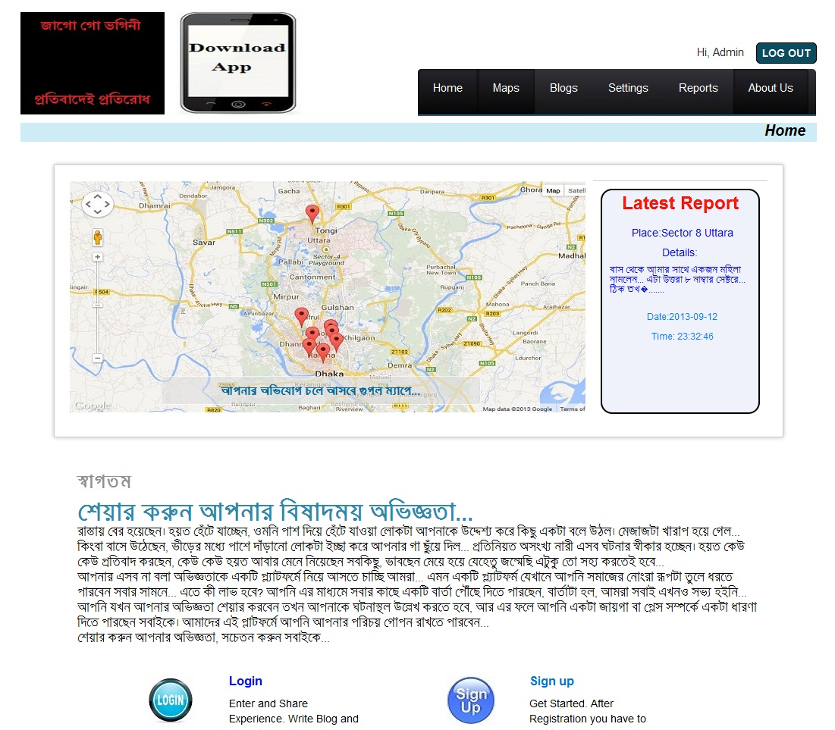
Protibadi website
Visualization of the crimes on the map
Online Reporting
Blogs
Protibadi Website

Slide 17
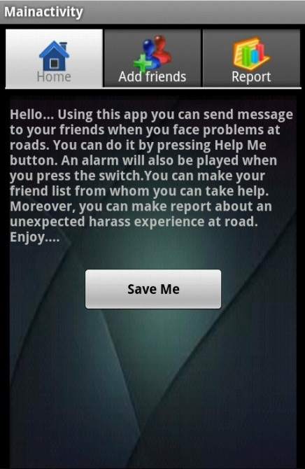
Protibadi mobile phone app
Emergency Help at at the spot
Instant Reporting
Asking help from friends
Protibadi mobile app

Slide 18
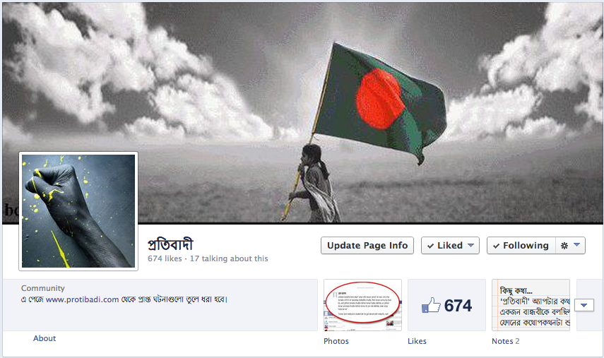
Protibadi Facebook Page
Sharing the reports, and related news and articles.
Discussion among the members
Protibadi Facebook Page

Slide 19
Usage, Feedback, and Public Responses
“yesterday i was going by rickshaw. it was going through a crowdy (sic. “crowded”) road. because of the crowd the rickshaw was going slowly. suddenly i felt that someone grabbed my thigh. i was shocked, i tried to find out who it was, then i saw a figure rushing towards the crowd. it was totally unexpected and really horrible..it happened near shyamoli area.”
- A report on Protibadi website
Three months after releasing the website, there were
  110 registered users (90 female, 20 male).
Users had entered 24 reports from different parts of Dhaka city,
618 people subscribed to the Facebook page,
  Each post was viewed by 350+ users on average.
Users also made 12 blog posts.

Slide 20
User Study
We conducted semi-structured interviews with 10 Protibadi users (contacted by site administrators via Facebook messages and conducted by female interviewers).
6 of the 10 respondents cited the value and comfort provided by the instant messaging system.
Participants also praised the reporting function, and mentioned the blog entries of other users as important sources of learning.
“The SMS system is very useful, because your information along with your location is instantly sent to an emergency contact person. Now you know you can get help anytime you are in trouble.”
-A “Protibadi” user

Slide 21
Additional Design Recommendations
Sharing the posts on Facebook.
Connecting the system to law-enforcement agencies or human-rights groups
Users preferred instead a platform where they could talk about any sort of harassment or discrimination in general.

Slide 22
Public Reactions and Controversies
Positive feedback from users, researchers, and media.
There are more than 1,000 downloads of the mobile app (according to the statistics collected on February 5, 2014)
Interest and uptake from different women’s non-profit organizations (including “Shorob”, a leading youth leadership program)

Slide 23
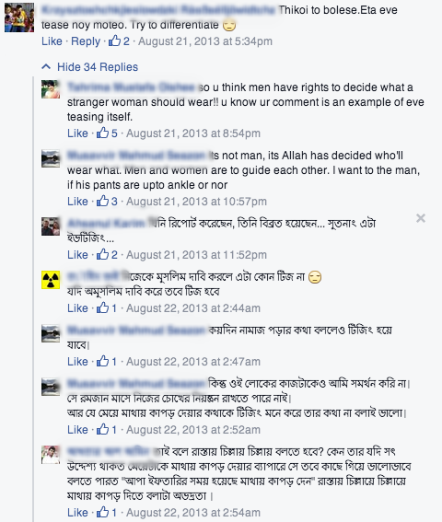
Public Reactions and Controversies (cont’d)
“... Any person can say to another woman to wear hijab and veil becoz it's farz [required] for women. If you don‟t admit it, then it's your mental problem”
-A Facebook user of Protibadi Facebook page
“…there must be a rigid partition to separate males and females, and all the fair must be collected from her male companion … so why r u fussing around with your so called feminism without rules of Shari’ah?"
-A Facebook user of Protibadi Facebook page
A screenshot from “Protibadi” Facebook page

Slide 24
Public reactions and controversies (cont’d)
“This is a great initiative, but there is a weakness in their intention. They are making this so that women can avoid the places where eve teasing takes place. If this continues we have to keep the women inside an almirah after a few days. They should instead post the pictures and profiles of the perpetrators.”
-A Facebook user commenting on “Protibadi” on Facebook.

Slide 25
Current status and future Directions
Protibadi is now being maintained and reconstructed by “Shorob”(a leading youth leadership program). New alternatives of this system are coming to the market.
We are trying to extend this system to the rural part of the country, where most of the women are illiterate.

Slide 26
Summary and Discussion
Deeper understanding of the problem of sexual harassment in urban Bangladesh
Methodological challenges in culturally sensitive areas of HCI work
Responses to available technologies, and identification of the limitations.
Challenges of HCI intervention around contested and unsettled cultural issues (HCI4D and feminist HCI) - design as agonistic, ambivalences, and unintended consequences

Slide 27
Thank You!
Questions, reactions, and suggestions are welcome.

