Slide 1

Technologies at Family Mealtime: Beyond the ‘Ordinary’
CHI 2015 Doctoral Consortium Presentation
of
Hasan Shahid Ferdous
PhD Student
Microsoft Social NUI Center
Dept. of CIS, University of Melbourne
Supervised by
Dr. Hilary Davis,
Dr. Bernd Ploderer,
A/Prof. Dr. Frank Vetere

Slide 2
Outline
Overview and Motivation
Related Works
Research Questions
Methodology
Study One: Design and Findings
Study Two and Three
Timeline for Study
Feedback from the Group

Slide 3
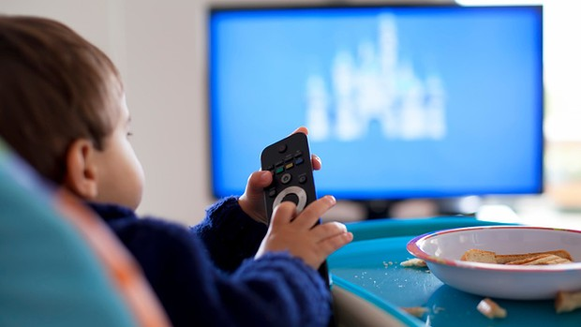
Communication Technology during Family Mealtime
Using communication technologies during mealtime is pretty common nowadays
  television, digital displays, video conferencing, emails, social networking sites, etc.
Unidirectional communication
  television, radio, etc.
Bidirectional communication
  Synchronous – Skype,
  Asynchronous – Emails
Group communications
  Public – Facebook,
  Private – Digital Display
Image Source: http://www.essentialbaby.com.au/toddler/toddler-education-and-play/my-children-watch-too-much-television-20131124-2y4d1.html

Slide 4
Motivation of Research
Technology usage during Family Mealtime
  Meals
  Technology
  FAMILY
Commensality – the shared experience of eating together
  Sharing life
  Social Norms
  Accountability

Slide 5
Related Works: Television during Family Mealtime
Research about the use of technology during mealtimes has been dominated by the television
  fifty percent of families have a television in the area where they commonly eat (Hersey et al. 2007; Coon et al. 2001),
  television-watching ratio during mealtime can be as high as 60% (Kirkova 2013)
Television watching associated with Poor dietary intake and hinders familial interactions
  Neumark-Sztainer et al. 2010, Boutelle et al. 2003, Fulkerson et al. 2008

Slide 6
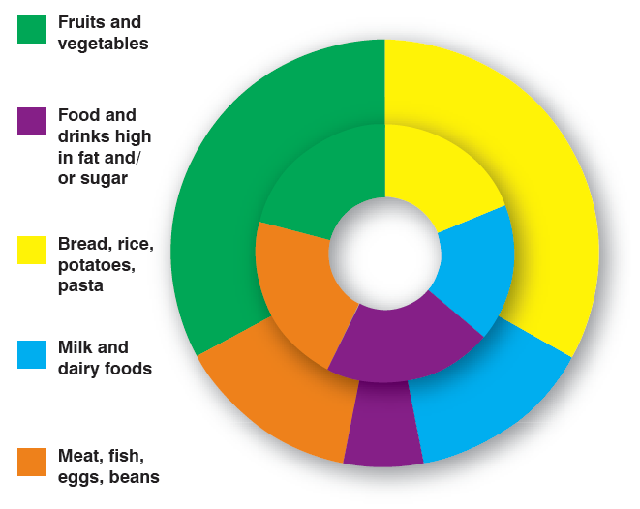
Related Works: Human Food Interaction
  Eat Well (Grimes et al. 2008)
    Low cost
    Nutritional awareness
    Community sharing knowledge
  Crowd Saucing (Linehan et al. 2013)
    Crowd-sourced data
    Encourage healthier eating
  Cooking Navi: (Hamada et al., 2005)
    Step by step guide
    Cooking multiple dishes

Slide 7
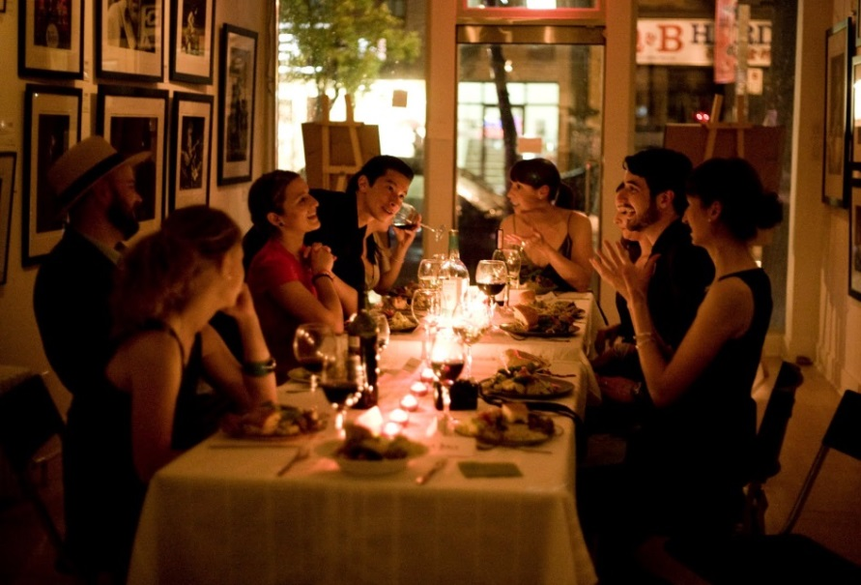
Related Works: Celebratory Eating
Celebratory Approaches
Kitchen Manifesto (Bell et al. 2002)
Celebratory Technology (Grimes et al. 2008)
Telematic Dinner Party (Barden et al. 2012)
Food-messaging (Wei et al. 2014)
Cookbook (Davis et al. 2014, Terrenghi et al. 2007)
Image Source: http://valentinecelebration.blogspot.com.au/2012/10/dinner-party.html

Slide 8
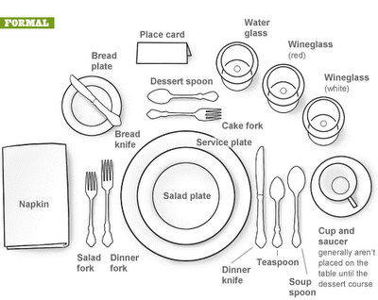
Related Works: Technological Practices during Mealtime
Phototalk in the context of sharing a meal (O’Hara et al. 2012)
  4Photos – a shared photo display
  Motivate shared reminiscence
  Support and provoke discussions
Laying the table for HCI (Hupfeld et al. 2012)
  Everyday practices associated with food
  The role of artefacts and space
Image source: http://theclassywoman.blogspot.com.au/2010/08/manners-monday-how-to-properly-set.html

Slide 9

Research Questions
How people use communication technologies during family mealtimes?
  RQ1. Which communication technologies are generally used and shared during the family mealtime? How are they used?
  RQ2. What contents from personal mobile devices can be shared with family members during mealtime? How does mobile technology use during mealtime impact on social interaction and togetherness amongst family members?
  RQ3. What is the experience of the developed technology regarding commensality and celebration for regular and special family mealtime?
Image Source: http://www.examiner.com/article/what-is-a-research-question

Slide 10
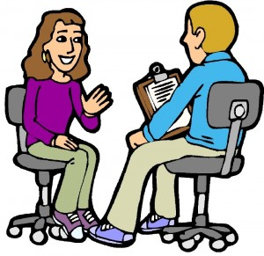
Research Design: Study One
First Study aims to understand the broader view of how family members use communication technologies around family mealtime.
  First interview with the family members
  Two self-recorded videos of family mealtimes
  Photographs of the family dining place
  Analyze the interviews, photos, and videos
  Second interview with the family members
Image Source: http://www.mymarketresearchmethods.com/an-overview-of-market-research-methods/

Slide 11
Participants
 | Family Members
Family 1 | Mother (professional), father (professional), two children
Family 2 | Mother (academic), father (academic), one child
Family 3 | Wife (doctor), husband (engineer)
Family 4 | Wife (student), husband (student)
Family 5 | Mother (book-keeper), three children
Family 6 | Mother (academic), father (businessman), three children

Slide 12
The Availability of Technology at Mealtimes
 | Ready-to-Hand Technologies | Present-at-Hand Technologies
Family 1 | • television, • mobile phone (for music) • tablet (for music), • Apple TV | • mobile phones (for call, text, or browsing), • tablet, • land phone, • laptop
Family 2 | • television, • mobile phone (for browsing, or music), • tablet (apps), • set top box | • mobile phone (for call or SMS), • desktop computer, • laptop computer, • smart light, • DVD player, • sound system, • tablet
Family 3 | • television | • mobile phone (for call, SMS, or browsing), • DVD player, • laptop, • land phone, • sound system
Family 4 | • laptop (for video streaming) | • mobile phone (for call, SMS, or browsing), • land phone
Family 5 | • television, • mobile phone (for social networking or SMS) | • mobile phone (for call or browsing), • tablet, • DVD player, • gaming console, • laptop, • desktop
Family 6 | • television, • DVD player, • sound system, • set top box, • Apple TV | • mobile phone (call, SMS, or browsing), • tablet, • land phone, • gaming console, • laptop, • desktop

Slide 13
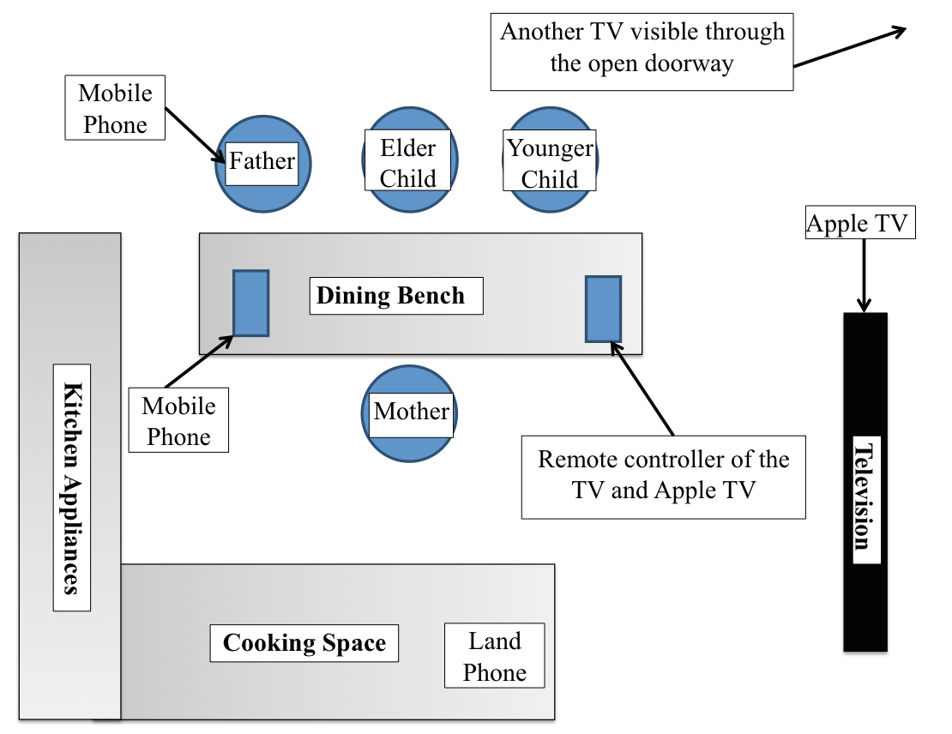
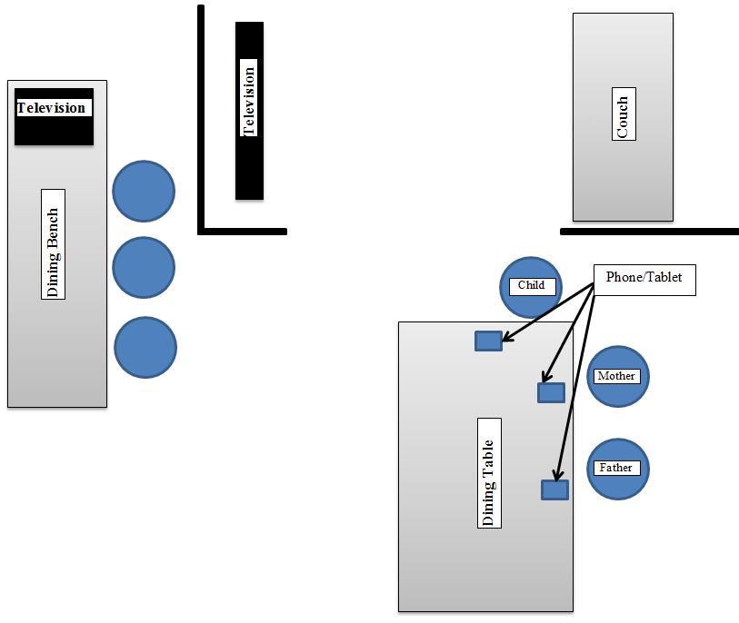
Spatial Arrangement of Technology during Mealtime
Technologies orientate to people
People orientate to technology
Hidden technology
Displaced technology
Family 1
Family 2

Slide 14
Mutual Shaping of Technology and Commensality
Technology and mealtime conversations
  Bidirectional relationship
Attention towards the technology
  Distractions are not always undesired
Balancing togetherness and technology consumption
  Tug-of-war
Technology for special occasions
  Special technologies or innovative ways
Technology and the Timing of the Consumption of Food
  Unhealthy vs. enjoyable

Slide 15
Research Design: Study Two
Explore the possibilities enabled by sharing the content from personal devices
Bring the personal to social.
Developing a smartphone application that supports the sharing of content
  Photos, Music
  Location
  Calendar
  Social Networks
  Global News, Tweets
We aim to investigate how such system can augment the social interactions, mediate usage, and/or bring tension/constraints among the family members during mealtimes.

Slide 16
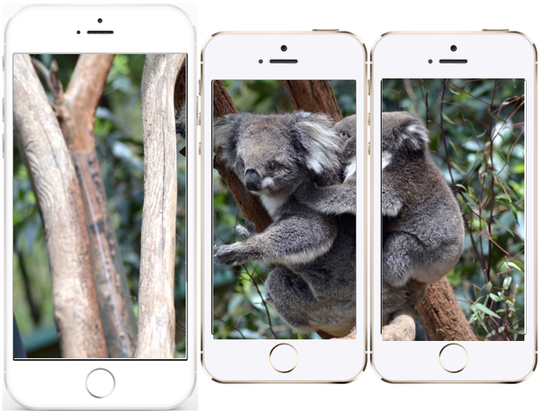
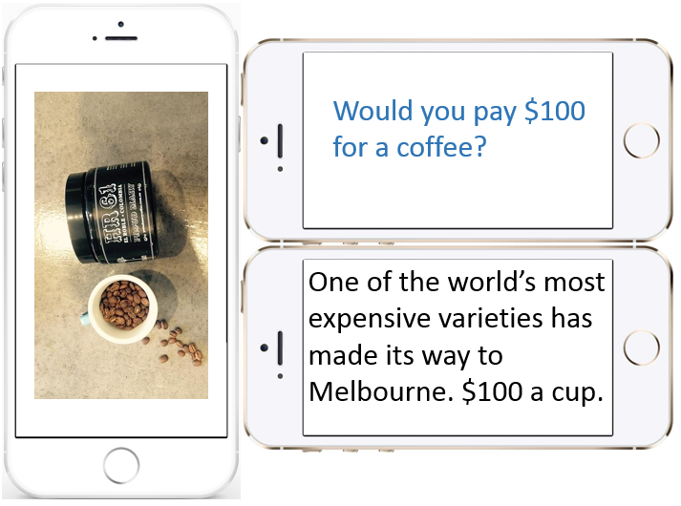
Shared Display using Personal Devices

Slide 17
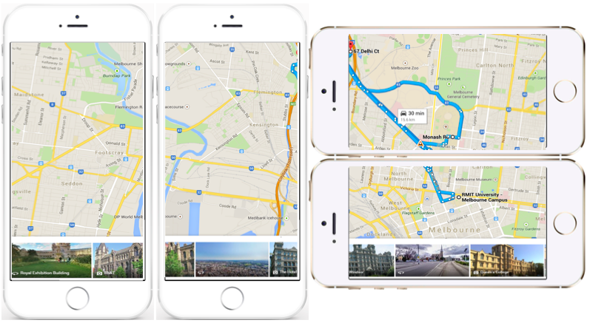
Shared Display using Personal Devices

Slide 18
Research Design: Study Three
Study three works as continuation from our study one and two.
Investigate the role shared devices can play during special and celebratory meals.
  often by the presence of extended family members

Slide 19
Timeline for Study
Aug’13 – May’ 14
Commence
OzCHI’13
Jun’14 – Dec’ 14
Study 1
Submit for CHI'15
Jan’ 15 – June’ 15
July’15 – Dec’ 15
Jan’ 16 – Aug’ 16
NUI Drawing Project
Literature Review
Ethics Proposal
Formal Review
Confirmation
Proposal for CHI DC
Study 3
Edit and submit thesis
Take leave
Submit Ethics for Study 2
Study 2
Submit paper at CHI’16
Plan for Study 3
Submit Ethics for study 3
Write Journal Paper for ToCHI
Writing Thesis draft
Attend CHI’15
Submit in OzCHI’15
24 Month’s Report

Slide 20
Feedback from the Group
Research Questions
  RQ1. Which communication technologies are generally used and shared during the family mealtime? How are they used?
  RQ2. What contents from personal mobile devices can be shared with family members during mealtime? How does mobile technology use during mealtime impact on social interaction and togetherness amongst family members?
  RQ3. What is the experience of the developed technology regarding commensality and celebration for regular and special family mealtime?
Study Three
Any suggestions

Slide 21

Thank You

