Slide 1


Hasan Shahid Ferdous
PhD Student, Microsoft Research Center for Social NUI
Dept. of CIS, University of Melbourne
Supervised by
Dr. Hilary Davis,
Dr. Bernd Ploderer,
A/Prof. Dr. Frank Vetere

Slide 2
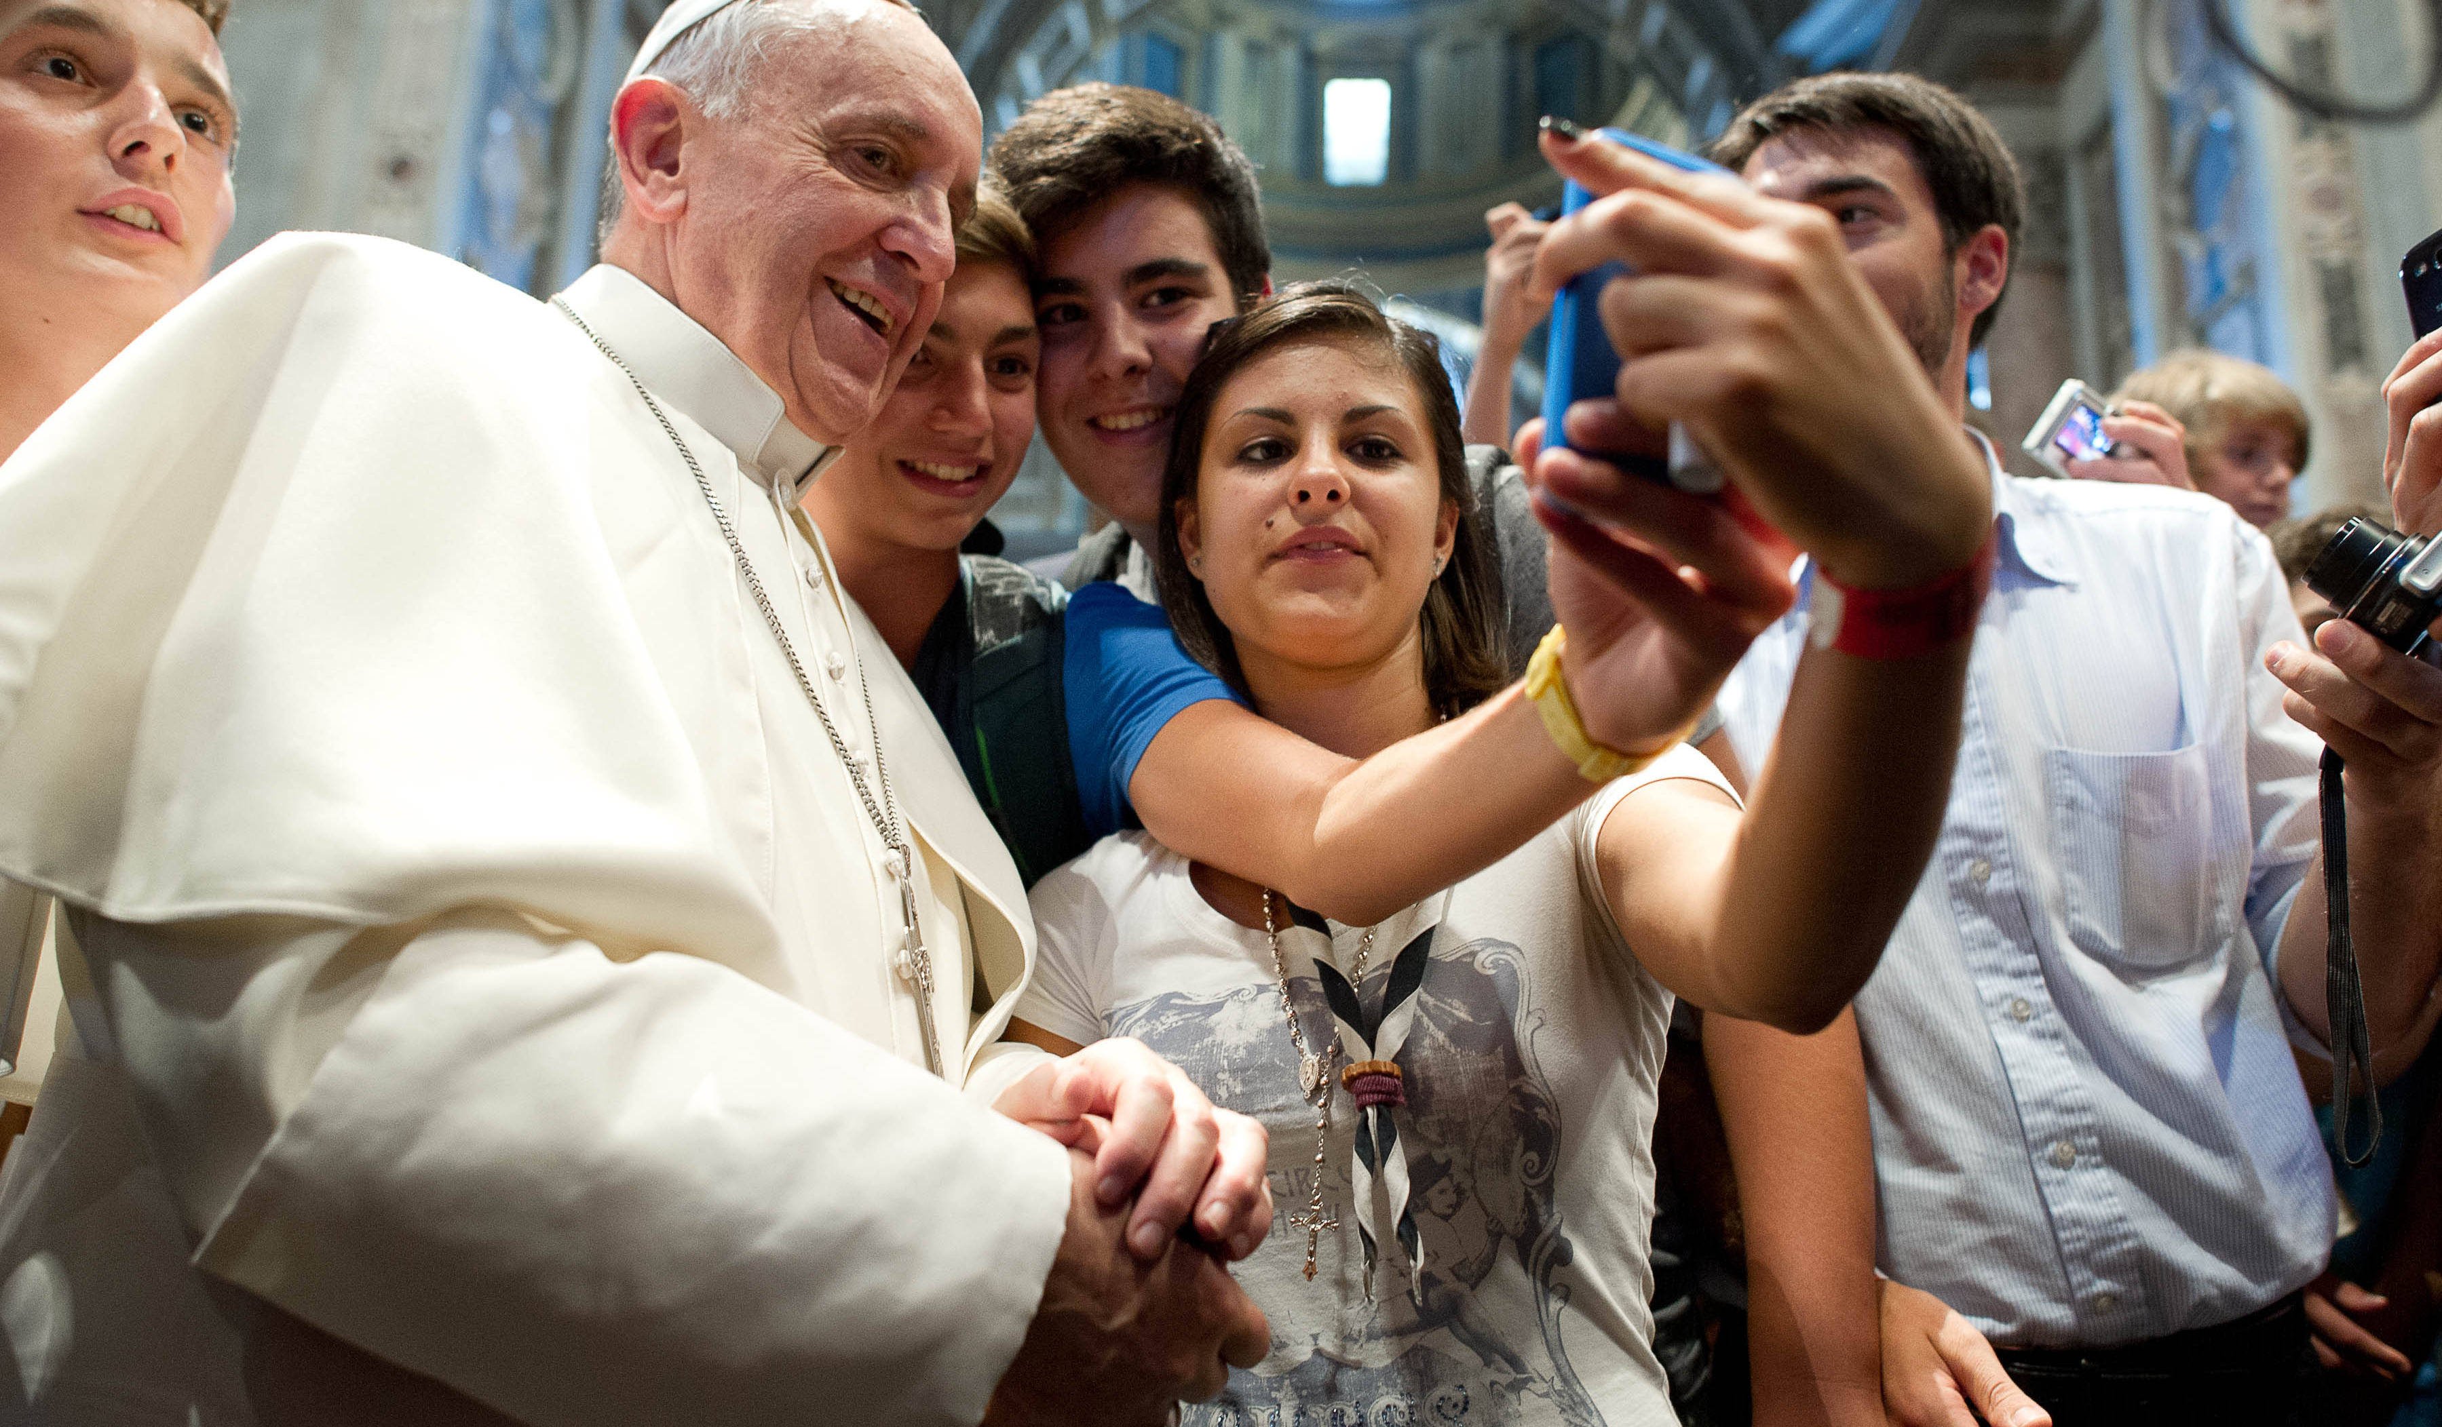
Don't use your phones at the dinner table
Pope Francis, St. Peter’s Square, Nov. 11, 2015
http://www.engadget.com/2015/11/13/pope-francis-hates-texting-while-eating/
http://technology.inquirer.net/files/2013/08/Vatican-Pope-Youths_Inte.jpg
http://www.catholicnewsagency.com/news/eat-with-your-family-not-with-your-smartphone-pope-says-79491/

Slide 3

Motivation of Research: Family Mealtime
The most concrete sign of this togetherness is when families are “gathered around the household table.”
“A family that almost never eats together, or that never speaks at the table but looks at the television or the smartphone, is hardly a family.” (Pope Francis)
http://blogs-images.forbes.com/offwhitepapers/files/2014/11/ap_pope_francis_jef_130926_16x9_9921111111111111.jpg

Slide 4
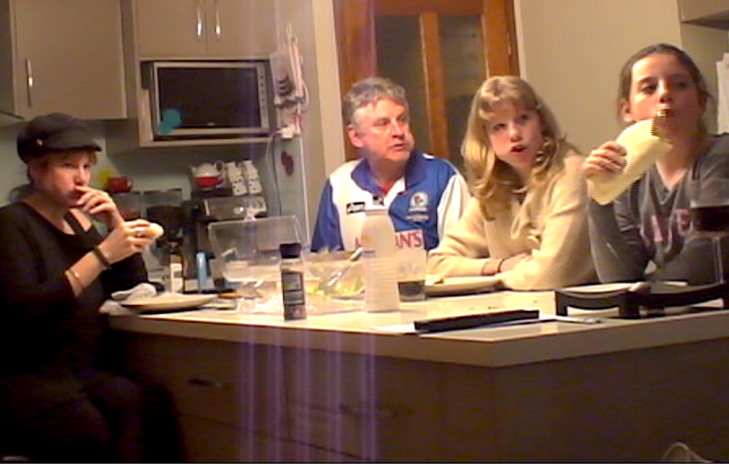
50% of families have a television in their dining area (Hersey & Jordan, 2007; Katharine et al., 2001)
Television-watching during mealtimes as high as 60% (Kirkova, 2013)
US survey found 63% of the respondents regularly have Television on during meals (Rideout et al., 2010)

Slide 5
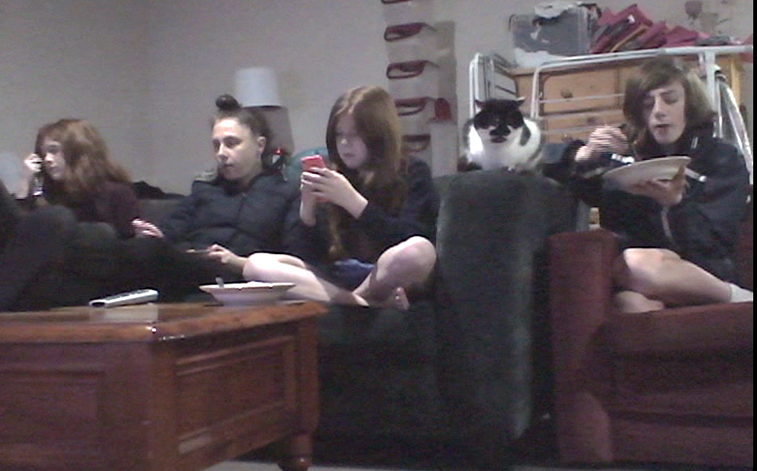
What about Mobile and Networked Devices?

Slide 6
  Technology usage during family mealtime
Seen as problematic
Novel interaction techniques –
  Social connectedness for solitary eaters (Grevet el al. 2012)
  Remote dining experiene (Barden et al. 2012, Wei et al. 2011)
  Multimodal sensory equipment: the use of sound, fragrance, light, etc. (Spence and Piqueras- Fiszman, 2013)
Few works to understand the social context of technology during mealtimes
  Meals and technology are often considered ‘separate’ independent entities.

Slide 7
Pairing Technology and Meals: A Contextual Enquiry in the Family Household
Hasan Shahid Ferdous, Bernd Ploderer, Hilary Davis, Frank Vetere, Kenton O’Hara
OzCHI 2015

Slide 8
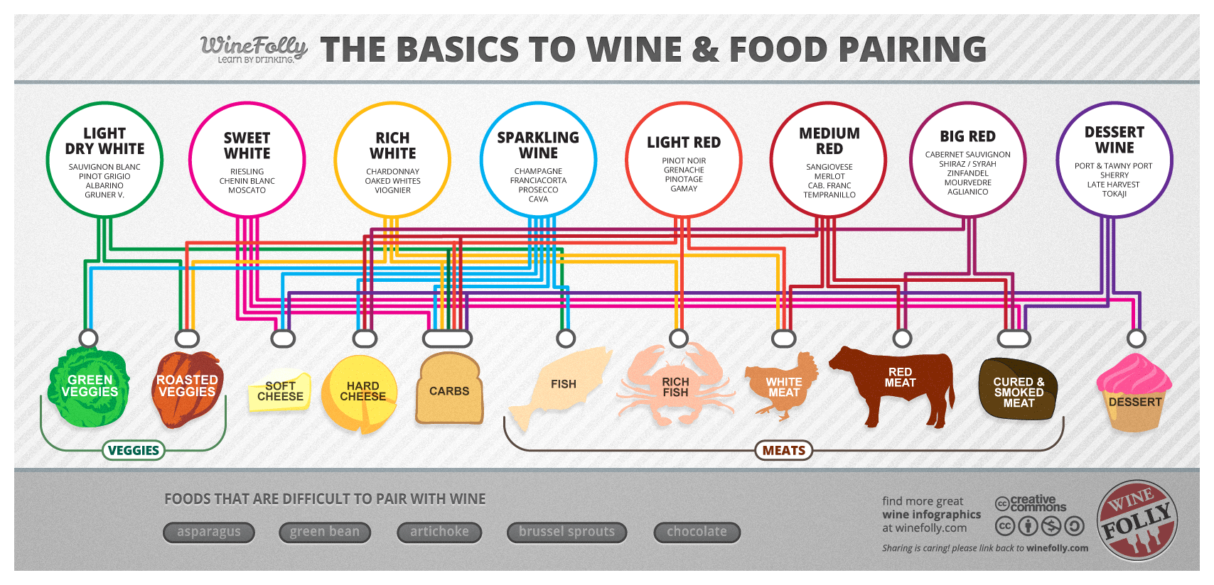
  ‘Pairing’ Technology and Meals

Slide 9
A Contextual Enquiry
Frame food practices in the households as enacting of the complex relationship encompassing
  the meal itself
  The members and their interrelationships
  surrounding elements
We were particularly concerned with context, interpretation, and focus.

Slide 10
Study Design: Two Phases
Aims to understand the broader view of how family members use communication technologies around family mealtime.
Phase One: Online forum discussion “Do you use phone, television, or any other device while you eat meals?”
Phase Two: In depth study with six Australian families
  Two interviews with the family members
  Two self-recorded videos of family mealtimes
  Photographs of the family dining place

Slide 11
Temporal Aspects in Technology Usage
Weekday vs. Weekend
  “It is very different on a Friday night I suppose, because we are closer to the TV... On Friday, we often get takeaway, and we’ll sit around here…, it is just as something different” (Father, family 6)
  “On weekends, the first things kids tend to do is to get up, get her iPad and play Minecraft. So the television might not be on but she will play Minecraft and she will probably play that right up until she has a breakfast, umm, and lunch.” (Mother, family 1)

Slide 12
Temporal Aspects in Technology Usage
Technology and Different Meals of the Day
  “I will check it [phone] in the morning, usually Facebook, Gmail, but she [wife] usually does not see it [Email] in the morning unless she has a meeting at 10 [am] so she just sees what the status is or if it’s still on time.” (Husband, family 4)
  “During lunch at work, I like to try and get out of the office because too often I’m stuck working through lunch anyway.” (P29)

Slide 13
Technology Usage and Sociality
Solitary Meals vs. Family Dinner Vs. Special Meals with Guests
Eating alone
  “Any time I eat by myself I’ll be found using some form of technology; at home I will be in front of the computer or at work/out and about I’ll play games on my phone or just general browsing.” (P26)
  Notable aspects: Companionship and in situ nature.

Slide 14
Technology Usage and Sociality
  Regular Family Meals
    “Growing up I was taught by my mum that eating in front of the TV was rude and as a result my sister and I were banned from doing so.” (P30)
  Special Members/Guests
    “On the rare occasions my Dad was home for work in time for ‘kids dinner’ at 6pm, my mum would insist we all sat at the dining table together with no TV on.” (P29)

Slide 15
Technology and Quality of the Meal
Junk Technologies for Junk Food
  “If it’ s a mealtime I won’ t let her play it [Minecraft] and eat. But if she is having a pack of chips or something, yeah, she will [play].” (Mother, family 1)
  “We try to watch those serials or those movies which do not require much attention. Some comedy series are seen out of order too.” (Wife, family 4)

Slide 16
Technology and Quality of the Meal
Good Food Encourages Less Technology Use
  “If the food isn’t good, we’re probably more likely to check our phones during the meal. But if it’s decent/awesome then we’d just eat and enjoy it along with each other’s company.” (P6)
  “There is no doubt; good food encourages conversation” (father, family 2)

Slide 17
Technologies for Special Occasions
Special Use of Technology
  Selection of movie for anniversary dinner (family 3)
Technology for creating ambience
  1920’s music for Birthday Party (family 1)
  Ambient lighting (family 2)

Slide 18
Discussions
Adjusted dynamically based on the context
  Routinely routine
  Family norms are rather loosely structured and regularly adapted to adjust to the context of the meal under consideration.
  Detailed and scrutinized plans for technology usage during special meals for a number of occasions throughout the year.
Technology at Mealtimes and Situated Timeliness
  technology use is paired with the timing of the meal (but typically not the other way around).

Slide 19
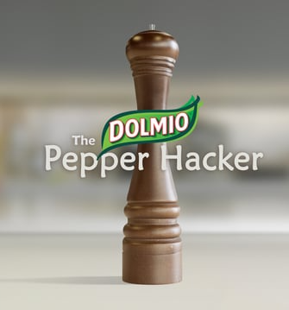
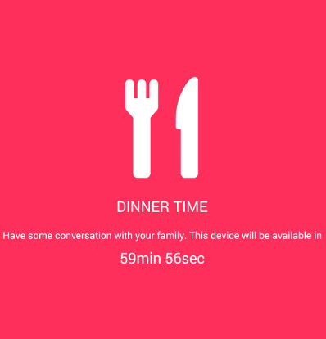
Restricting Technology Usage
http://www.androidparent.com/wp-content/uploads/2014/08/dinnertime.jpg
https://i.vimeocdn.com/video/527546976_640.jpg

Slide 20
Technology and Familial Interactions
Technology practices are significantly shaped by our social setting, and the social setting is equally shaped by such practices.
Food and technology cannot be considered separately
  Meals,
  Efforts in preparation,
  Appreciation by family members.

Slide 21
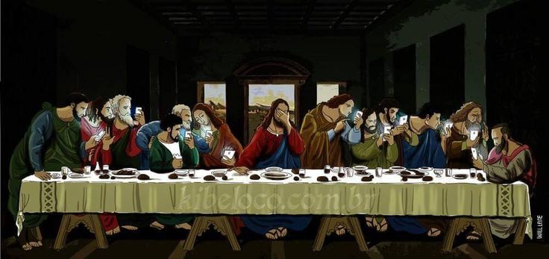
https://s-media-cache-ak0.pinimg.com/736x/1b/8b/64/1b8b642efc25690a2144bc12826093d0.jpg

Slide 22

Thank You

