Slide 1


Technologies At Mealtime:
Collocated Interactions In The Family Home
Hasan Shahid Ferdous
PhD Student, Microsoft Research Center for Social NUI
Dept. of CIS, University of Melbourne
Supervised by
Frank Vetere, Bernd Ploderer,
Hilary Davis, Kenton O’Hara

Slide 2
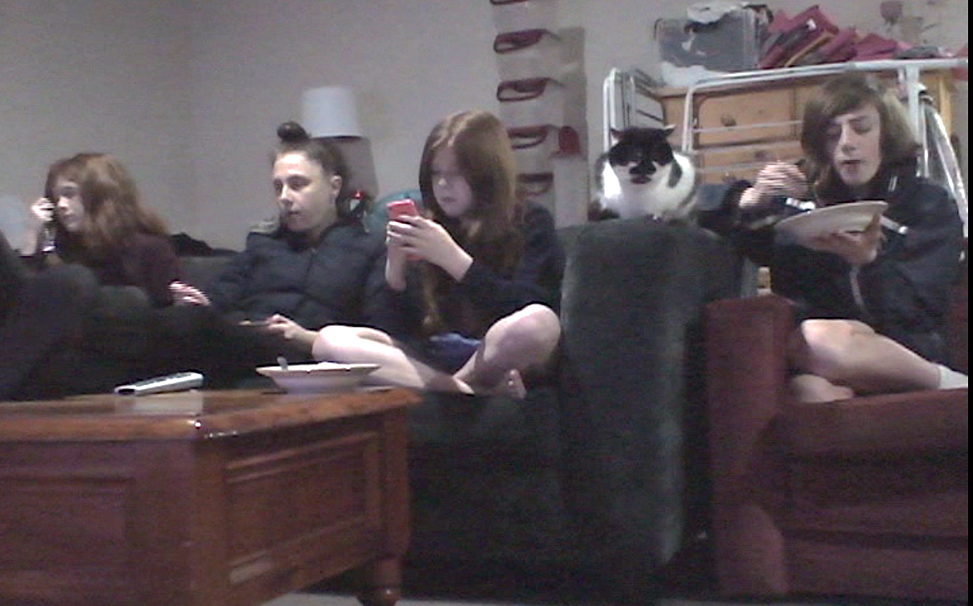

Slide 3
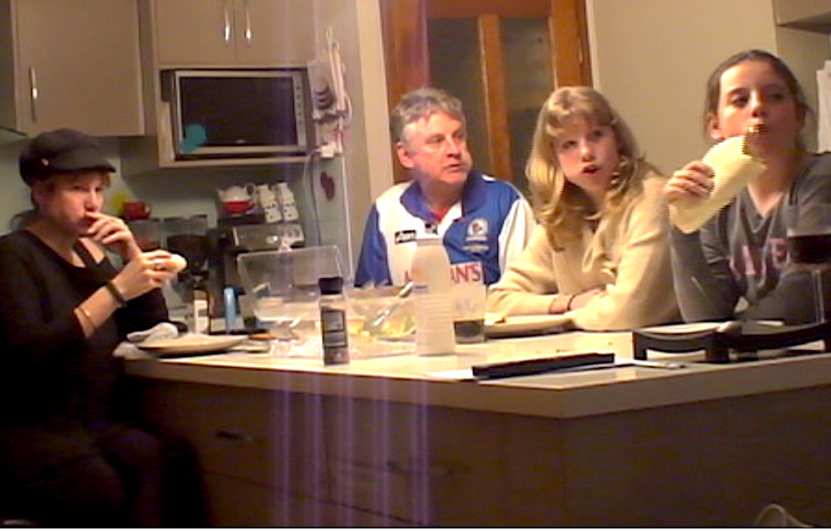
Spatial Arrangement of Technology at Mealtime
Technologies orientate to people
People orientate to technology
Hidden technology
Displaced technology

Slide 4
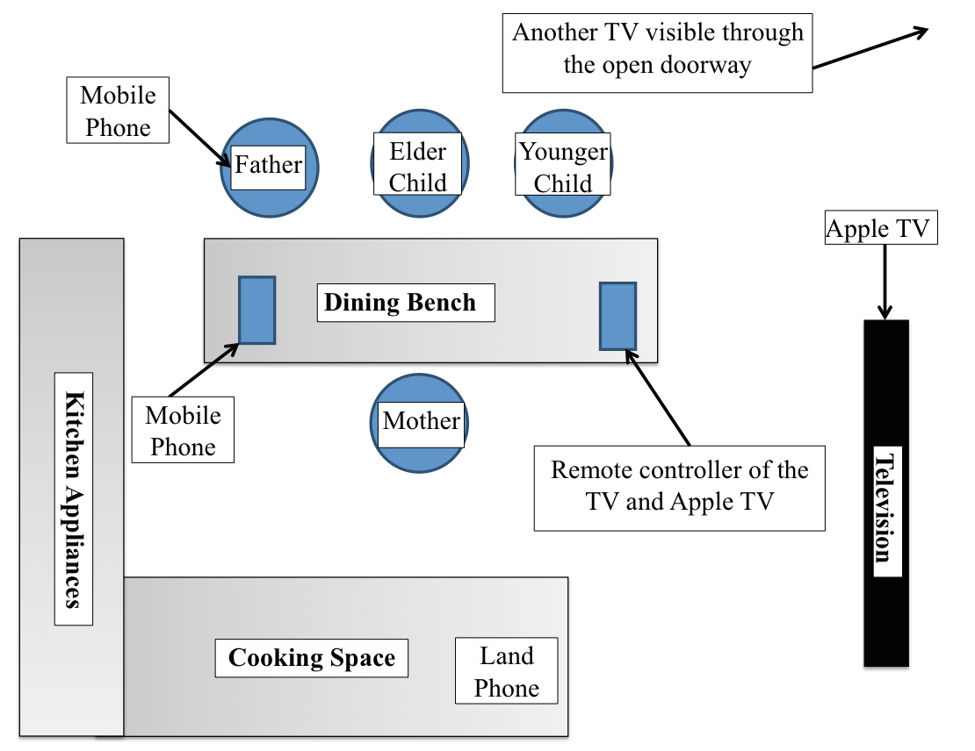
Spatial Arrangement of Technology at Mealtime
Technologies orientate to people
People orientate to technology
Hidden technology
Displaced technology

Slide 5
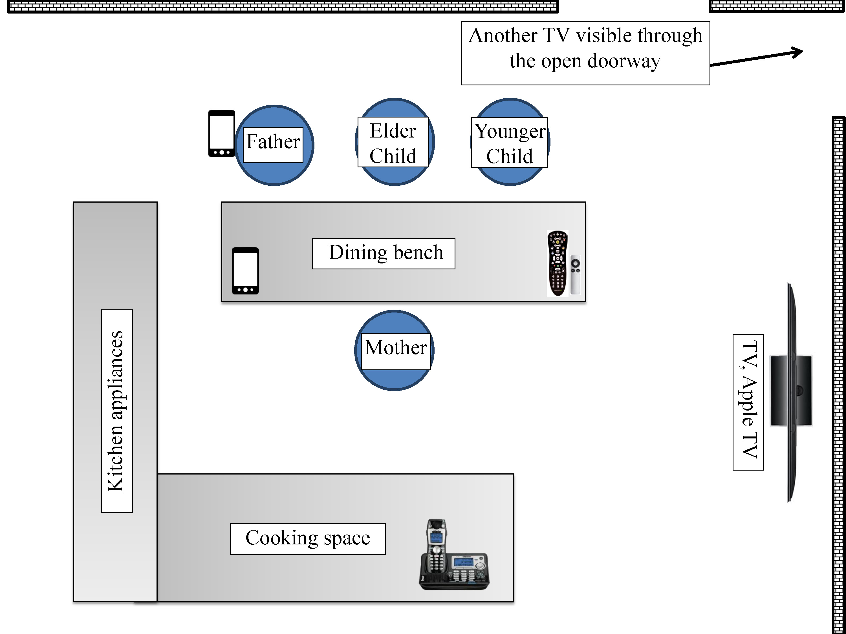
Technology and Familial Interactions
Notes:
Technology remain at the background – no one is looking at it all the time. This is NECESSARY. If requires CONSTANT ATTENTION, it is not allowed.
Provokes conversation and support conversation – people relate the media with their own memory, uses technology to support the ongoing need and conversation
Distraction is not always bad

Slide 6
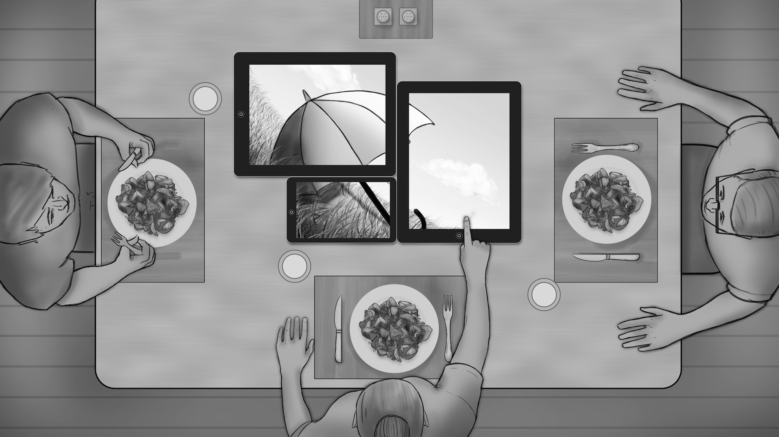
Notes:
During Deployment,
Family members looked into it for a second and then talked among themselves

Slide 7
TableTalk: Sharing Technology and Life at Family Mealtimes
Notes:
During Deployment,
Family members looked into it for a second and then talked among themselves

Slide 8

Thank You

