Slide 1
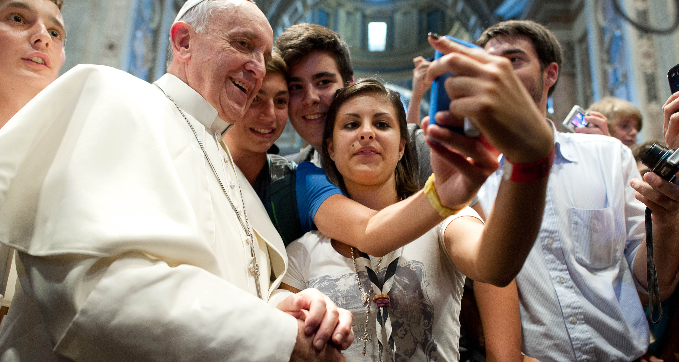
“Don’t Use Your Phones At The Dinner Table”
Pope Francis, St. Peter’s Square, Nov. 11, 2015
http://www.engadget.com/2015/11/13/pope-francis-hates-texting-while-eating/
http://technology.inquirer.net/files/2013/08/Vatican-Pope-Youths_Inte.jpg
Notes:
Don’t Use Your Phone at the dinner table.
On November 2015, when I read this quote as a news headline, I was a bit shocked. Did His Holiness criticized my research? But as I read through the article, I was assured that he was not.

Slide 2

Hasan Shahid Ferdous
PhD Student, Microsoft Research Centre for Social NUI
Dept. of CIS, University of Melbourne, Australia
Supervised by
Prof. Frank Vetere and Dr. Hilary Davis
Notes:
Visiting research student,
Thanks Rob, and Geremy for supervising me,
and Patrick for allowing me the opportunity to visit OpenLab
3rd year PhD student
Broad overview of my PhD research
The three studies I have done as a part
Feedback on the overall narrative of my research

Slide 3
Technology Usage At Family Mealtimes
Notes:
What are the current practices?

Slide 4
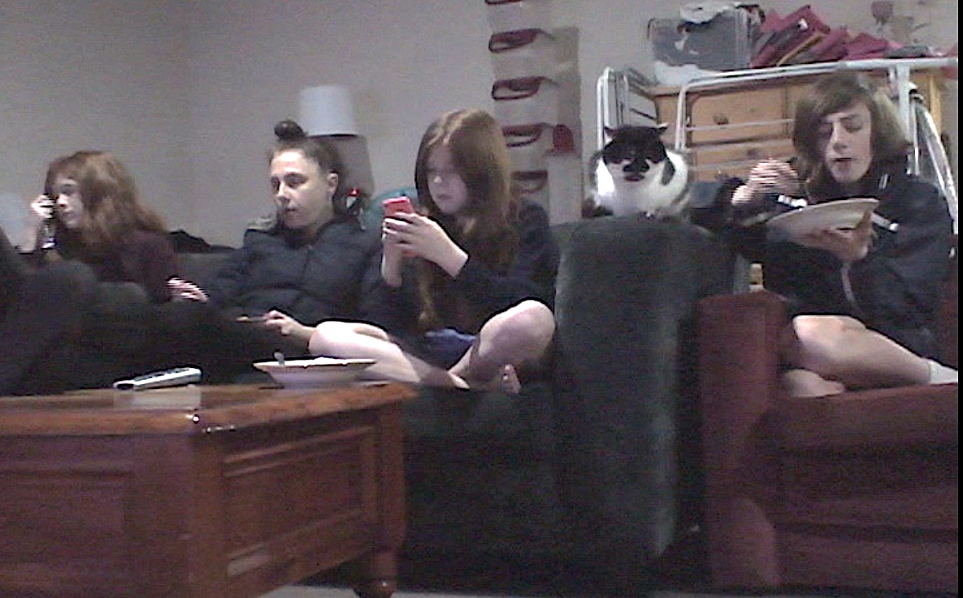
Technologies at Family Mealtimes
The Good, The Bad, and The Ugly
Notes:
I am Hasan Shahid Ferdous, and my PhD research concerns technology usage at family mealtimes.
In this research, we ask what is the role of technologies in this space, and identify the GOOD, the BAD, and the Ugly.
Now, here we see an example of “The Ugly”
----
Family mealtimes are important site for the social construction shared knowledge, sensibilities, and moral perspectives.
THE ONLY TIME OF THE DAY when all members come together.
Family mealtimes are important site for the social construction shared knowledge, sensibilities, and moral perspectives. Technologies, particularly Television has received much attention, especially from sociological and health perspectives. However few have explored the roles, practices, and attitudes for mobile and connected devices that now are finding a place in our everyday mealtime routines.

Slide 5
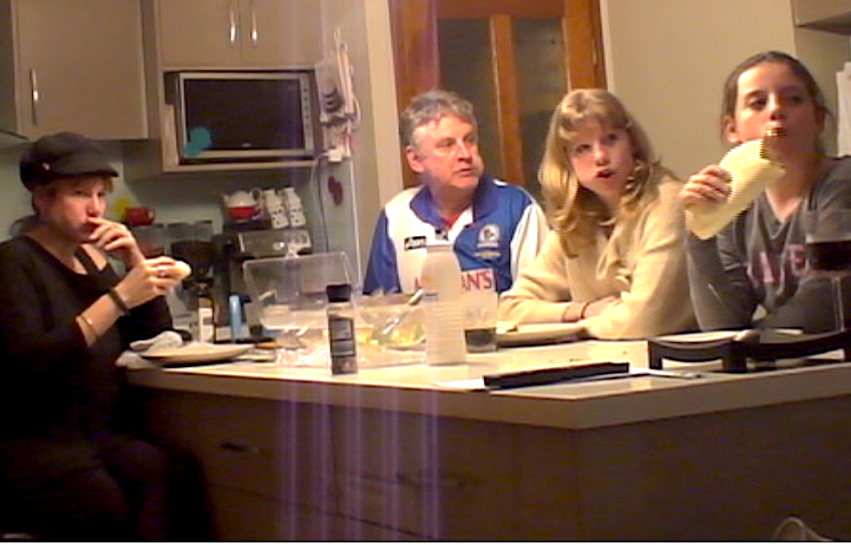
Technologies at Family Mealtimes
The Good, The Bad, and The Ugly
Notes:
Shared
Criticism from social and health perspectives
Good?

Slide 6
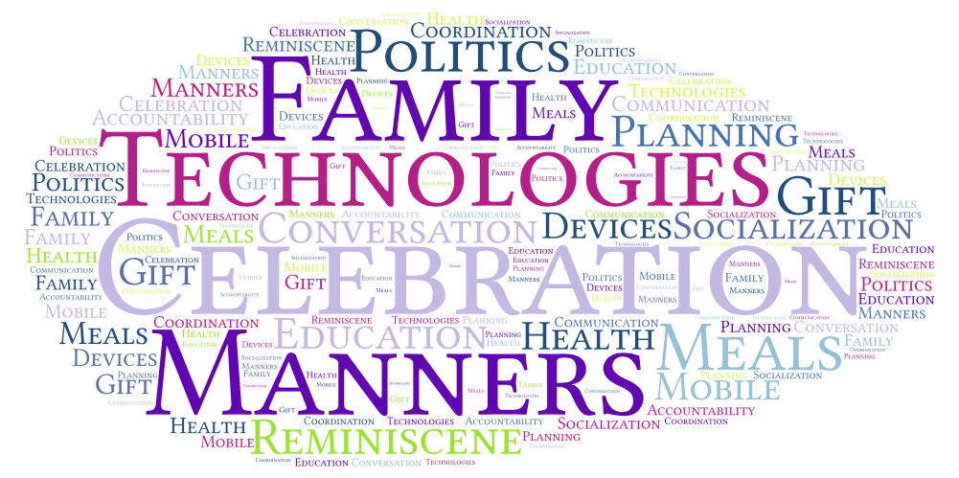
Notes:
Commensality
So it is not only the family conversation as the concern, but the bonding nurtured through such means, and other practical (and sometimes intentional) opportunities, i.e., FAMILY ACCOUNTABILITY, EVENT PLANNING, EDUCATING AND SOCIALIZING CHILDREN, ETC. that have been of interest to us.
We ask, what is the role of technologies in relations to these aspects of commensality?
We started with an exploration to understand the current practices, and how families manage these devices.

Slide 7
Understanding Technology Use At Mealtimes
Each family develops their own norms and practices to
  Manage interactions
  Support togetherness
A mix of positives and negatives
  Technology both provoked conversation and supported conversation
The role of personal devices
  Usage can involve tension
  Managed, but not kept away

Slide 8
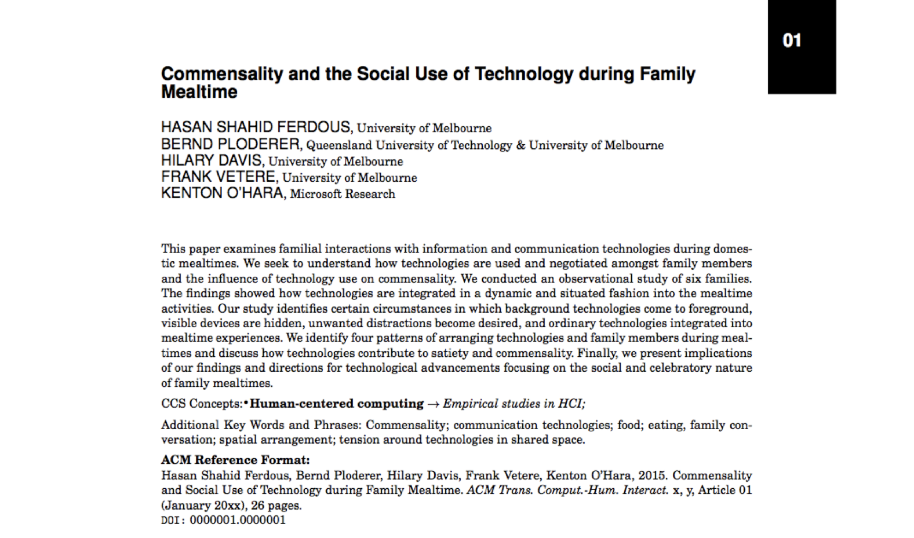
TOCHI Article (Accepted)

Slide 9
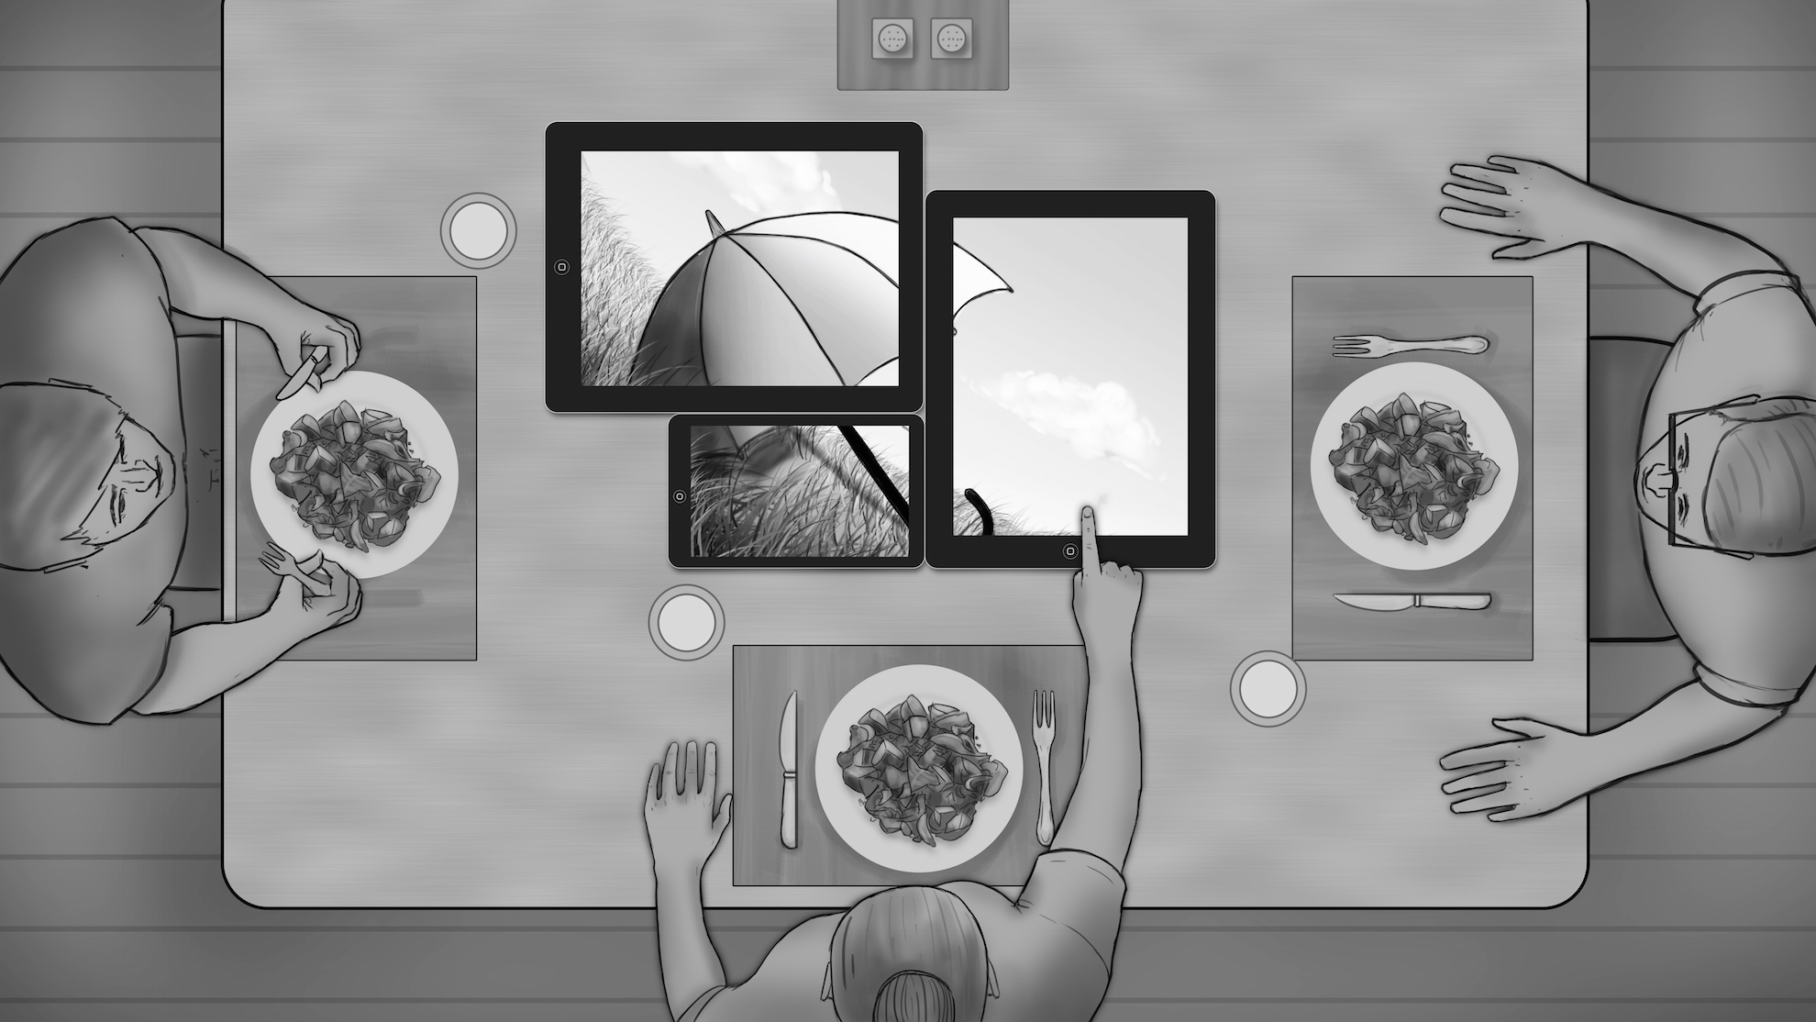
TableTalk: Sharing Technology and Life at Family Mealtimes
Notes:
Convert personal devices into shared resource

Slide 11
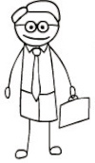



Research Method & Participating Families

Slide 12
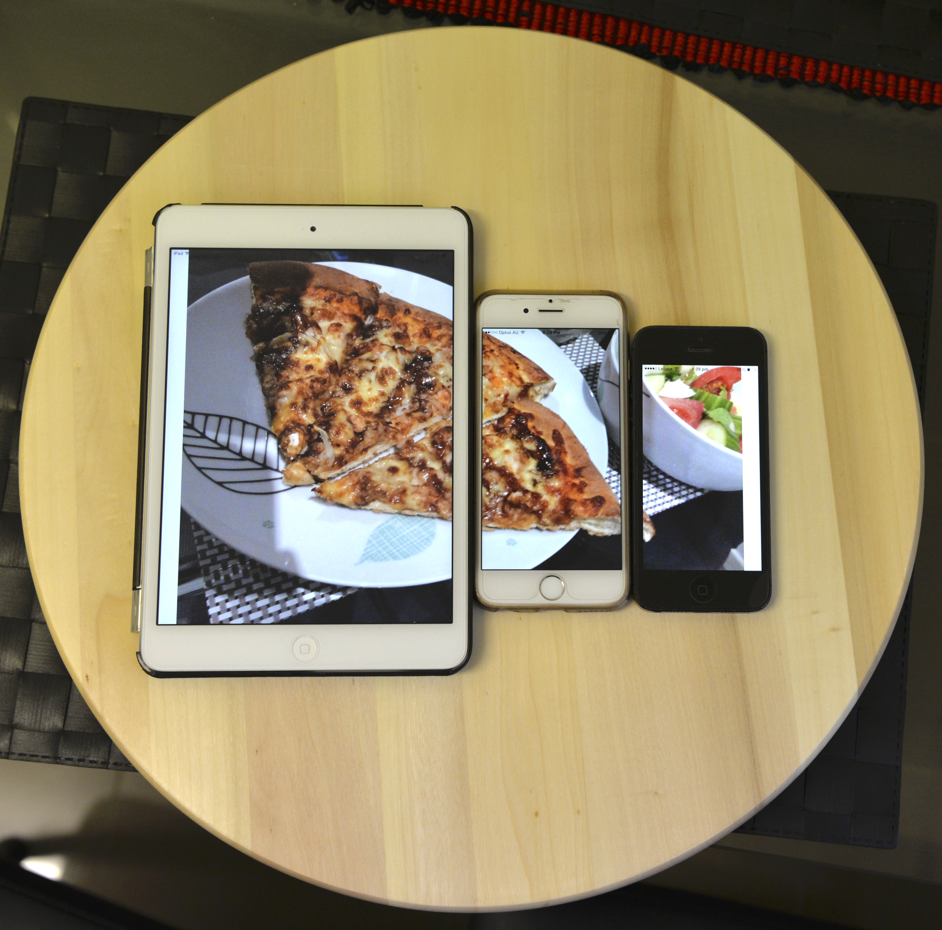
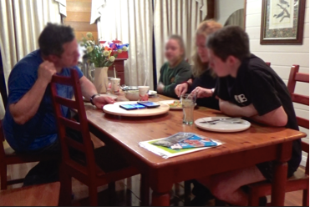
Setting Up the Physical and Social Space
Physical arrangement
User interaction
Collective significance in usage
Moderation & ethical concerns

Slide 13
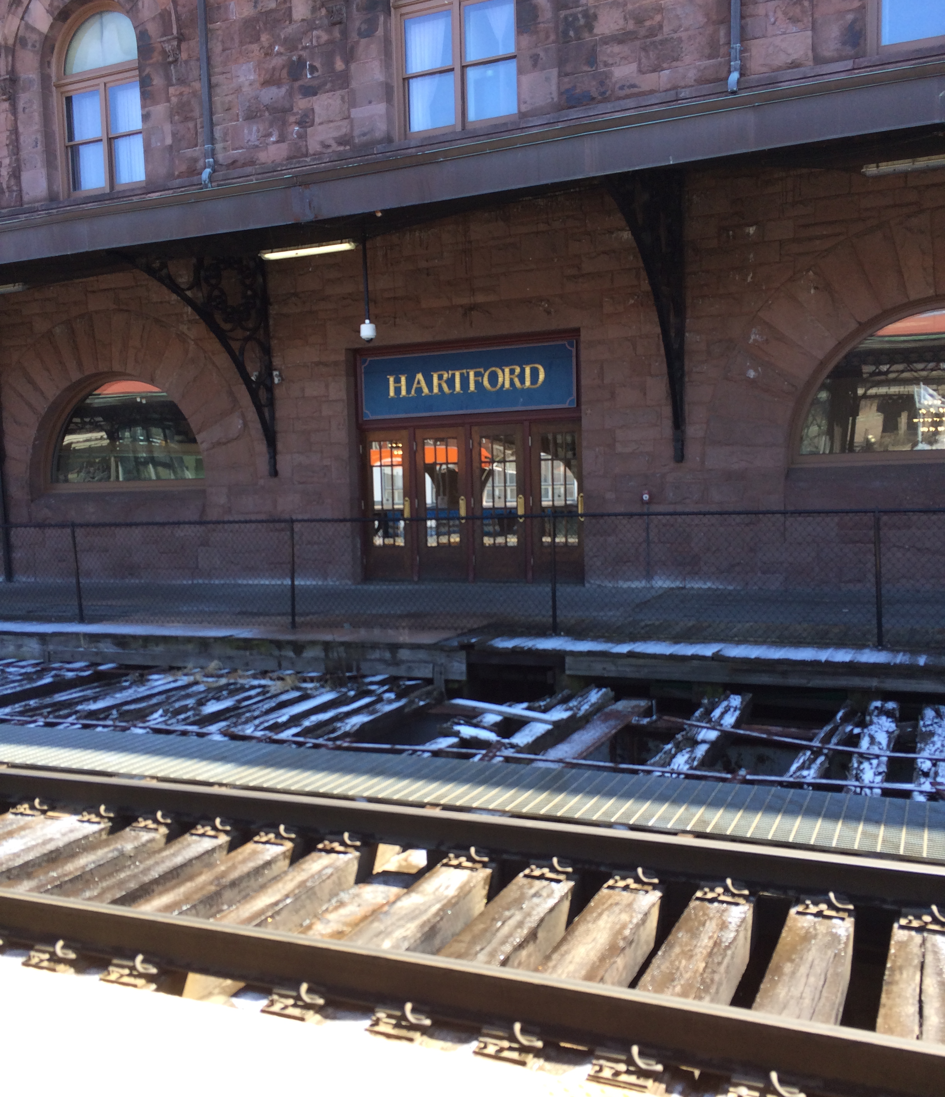
TableTalk and the Family Interactions

Slide 15
Notes:
During Deployment,
Family members looked into it for a second and then talked among themselves

Slide 16
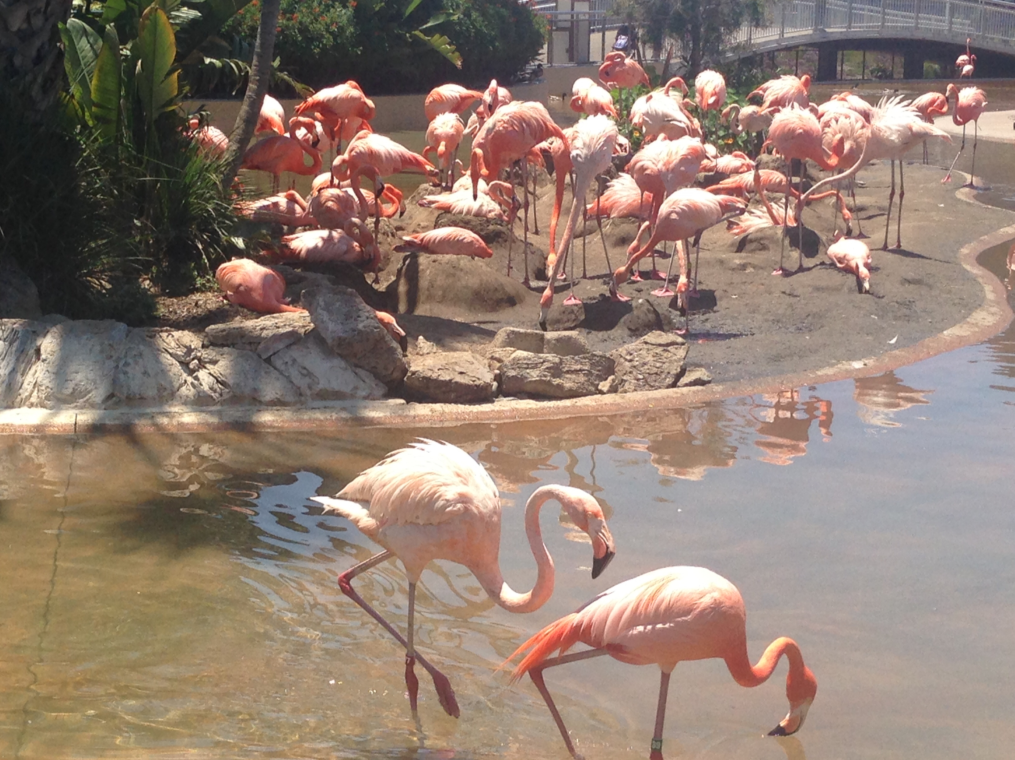

Slide 19
Notes:
Family mealtimes are important site for the social construction shared knowledge, sensibilities, and moral perspectives.
THE ONLY TIME OF THE DAY when all members come together.
So it is not only the family conversation as the concern, but the bonding nurtured through such means, and other practical (and sometimes intentional) opportunities, i.e., FAMILY ACCOUNTABILITY, EVENT PLANNING, EDUCATING AND SOCIALIZING CHILDREN, ETC. that have been of interest to us.
We ask, what is the role of technologies in relations to these aspects of commensality?
We started with an exploration to understand the current practices, and how families manage these devices.

Slide 20
Discussion: What We Have Learnt
Notes:
Convert personal devices into shared resource

Slide 21
Make Family Meals
Great Again…

Slide 22


Role of Technologies at Family Mealtimes
vs.
Notes:
What we have learned from this research?
Counter Intuitive
Families try to make it work. Technology usage at mealtimes are not arbitrary, but families developed their own set of norms over time.

Slide 23
“Heart, Mind, and Will”
Good Intention – Identify or build on human intentions
Discernment – Use intervention to amplify the right human force
Self Control – Avoid indiscriminate dissemination

Slide 24
Future Works
Long Term Deployment
Compare meals with and without TableTalk
SIMPLE – Similar Items from Multiple Persons for Longer Expression

Slide 25
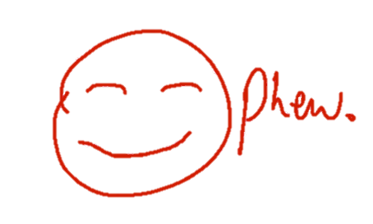

Slide 26

Thank You

Slide 27
References
Hupfeld, A. and Rodden. T. Laying the table for HCI: uncovering ecologies of domestic food consumption (CHI 2012)
Jeffery, R.W. and French, S.A. (1998) Epidemic obesity in the united states: Are fast foods and television viewing contributing? American journal of public health, 88, 277-280.
Judge, T. K. and Neustaedter, C. 2010. Sharing conversation and sharing life: video conferencing in the home. In Proceedings of the SIGCHI Conference on Human Factors in Computing Systems (CHI '10).
Kanai, H., and Kitahara, K. (2011). Menu-planning Support System to Facilitate Communication among Neighbors. CSCW’11.
Kirkova, D. (2013) http://www.dailymail.co.uk/femail/article-2292657/Britons-eat-meals-television-new-research-reveals-nation-dining-table-dodgers.html, Accessed on 12/06/2015.
Linehan, C. , Leeman, T. , Borrowdale, C., Lawson, S. “Crowd Saucing: Social Technology for Encouraging Healthier Eating”, Interactions, Jan. 2013.
Neumark-Sztainer, D., Larson, N. I., Fulkerson, J. A., Eisenberg, M. E. and Story, M. (2010). Family meals and adolescents: what have we learned from Project EAT (Eating Among Teens)? Public Health Nutrition, Vol. 13, No. 1, pp. 1113-1121.
O'Hara, K., Helmes, J., Sellen, A., Harper, R. H. R., Bhömer, M. T., & Hoven, E. V. D. (2012) Food for Talk: Phototalk in the Context of Sharing a Meal. Human-Computer Interaction 27(1-2): 124-150
Terrenghi, L., Hilliges, O. and Butz. A. Kitchen stories: sharing recipes with the Living Cookbook. PUC, 2007
Tolmie, P., Pycock, J., Diggins, T., MacLean, A., and Karsenty, A. 2002. Unremarkable computing. In Proceedings of the SIGCHI Conference on Human Factors in Computing Systems (CHI '02).
Wei, J., Wang, X., Peiris, R. L., Choi, Y., Martinez, X. R., Tache, R., Koh, J. T. K. V., Halupka, V. and Cheok, A. D. CoDine: an interactive multi-sensory system for remote dining. Proceedings of UbiComp '11.
Wei, J., Ma, X., & Zhao, S. (2014, April). Food messaging: using edible medium for social messaging. In Proc. CHI’14 (pp. 2873-2882). ACM.

