Slide 1

Hasan Shahid Ferdous
PhD Student, Microsoft Research Centre for Social NUI
School of CIS, University of Melbourne, Australia
Co-Authors: Bernd Ploderer, Hilary Davis,
Frank Vetere, Kenton O’Hara

Slide 2


Slide 3
Commensality &
Social Use of Technology
at Family Mealtime

Slide 4
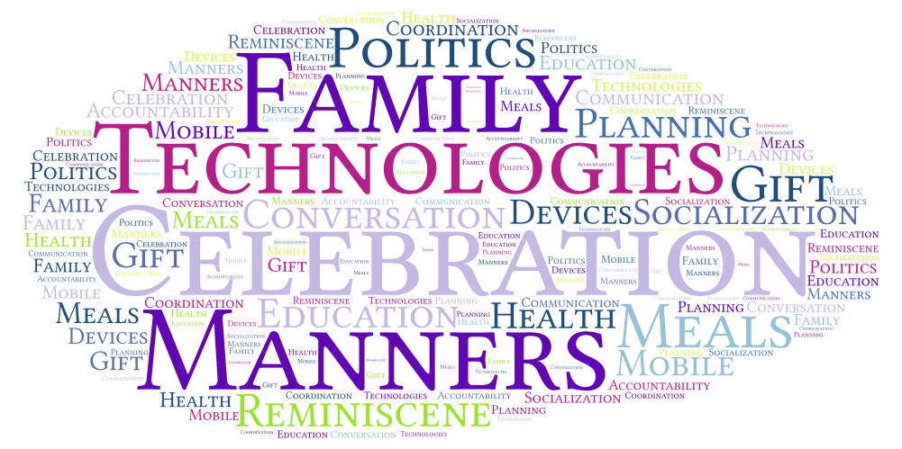
Notes:
Let’s take a minute for some reflection.
What do you remember about your food? Do you feel good? Any positive memories? Try the last time you had a special dinner with family and friends. What came to your mind.
If you memory is something positive – than you will be interested in this talk.
If it is not, you will be thrilled.
What do you remember of popcorn? Cynema?

Slide 5
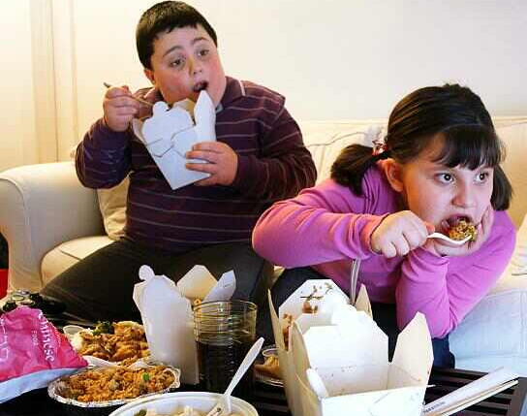
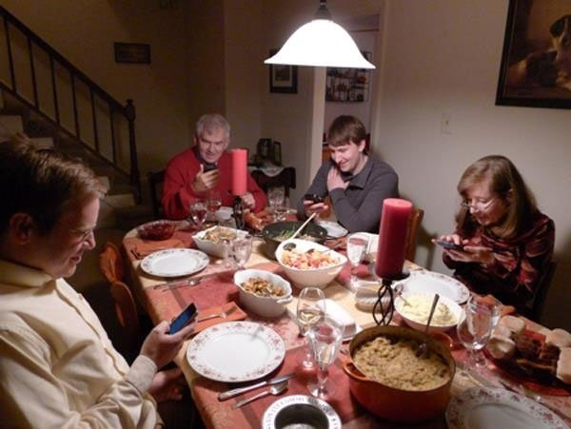
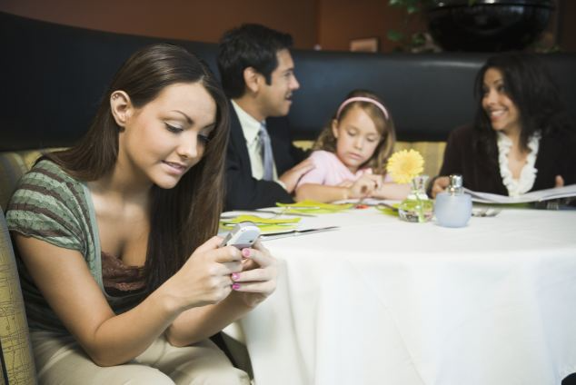
http://www.express.co.uk/comment/columnists/vanessa-feltz/547078/Vanessa-Feltz-on-ready-meals-Rebecca-Adlington-and-Ben-Ofoedu
http://www.ara.cat/societat/reduir-lobesitat-infantil-passar-quirofan_0_1681031915.html
http://baddogneedsrottenhome.com/page.html?image=2611
http://www.dailymail.co.uk/sciencetech/article-2213456/How-putting-phone-dinner-table-convince-friends-dont-care.html

Slide 6
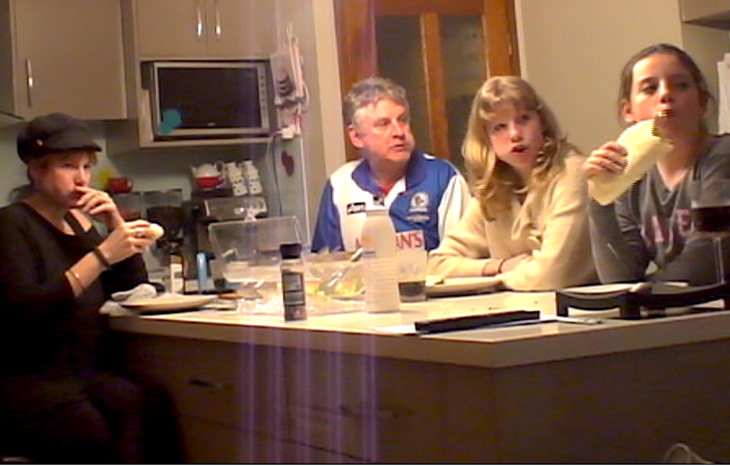
[Coon et al. 2001]
[Kirkova 2013]
[Orlando. 2016]
Notes:
Families watching television together. They are not concentrating on each other, but at least they are enjoying something together, and not on separate screens.
That’s the BAD part

Slide 7
Notes:
Families watching television together. They are not concentrating on each other, but at least they are enjoying something together, and not on separate screens.
That’s the BAD part

Slide 8
Corrective Technologies
Inefficiency
Uncertainty
Inexperience
Distraction
Lack of Information
[Bonanni et al. 2005]
[Mankoff et al. 2002
Chi et al. 2007]
[Svensson et al. 2001, 2005]
[Hamada et al. 2005
Tran et al. 2005]
[Nakauchi et al. 2005
Ju et al. 2001]
Notes:
HUMAN ERROR
The corrective technologies attempt to ameliorate the undesirable aspects of the human in the interaction with food. They inform individuals (to reduce inefficiency, increase nutrition knowledge, and compensate for
inexperience, for instance); they assist and guide individuals (to reduce uncertainty and compensate for inexperience); and they tame the environment (to reduce users’ distraction).
HCI solves problems in interaction design with food not because people have problems with computers but because people have problems with themselves.
uncertainty would be turned into certainty, inexperience into aptitude. In our mind, the resulting systems are corrective technologies insofar as they attempt to fix undesirable behaviors.

Slide 9
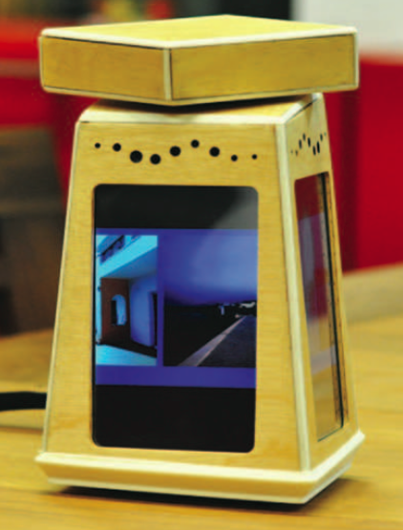
Notes:
Celebratory Technology Agenda

Slide 10
HCI: Enjoying Meals
Sociology and Health
Research
Gap
HCI: Problem Solving
Notes:
Positives?
Celebratory?
Everyday?
INTERSECTION between these
EVERYDAY Commensality, found in the mundane nature of it
Focus on technology usage,
how families manage the Interaction with and around the technologies
Impact on the commensal experience

Slide 11
Research Question
How communication technologies are used and managed by the family members at mealtimes?
Notes:
Explore CURRENT PRACTICES

Slide 12
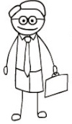

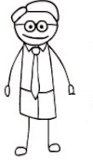


Participating Families

Slide 13



Participating Families

Slide 14
Research Methods
Pre-Interview
Home Tour
2 Videos of Regular meals
Post-Interview

Slide 15
Research Methods
Home Tour

Slide 16
The Availability of Technology at Mealtimes
 | Ready-to-Hand Technologies | Present-at-Hand Technologies
Family 1 | Television, mobile phone or tablet (for music), Apple TV | Mobile phones (for call, SMS, or browsing), tablet, land phone
Family 2 | Television, mobile phone (for browsing, or music), tablet (apps), set top box | Mobile phone (for call or SMS), desktop, laptop, smart light, DVD player, sound system, tablet
Family 3 | Television | Mobile phone (for call, SMS, or browsing), DVD player, laptop, land phone, sound system
Family 4 | Laptop | Mobile phone (for call, SMS, or browsing), land phone
Family 5 | Television, mobile phone (social networking or SMS) | Tablet, mobile phone (for call or browsing), DVD player, gaming console, laptop, desktop
Family 6 | Television, DVD player, sound system, set top box, Apple TV | Mobile phone (call, SMS, or browsing), tablet, land phone, gaming console, laptop, desktop

Slide 17
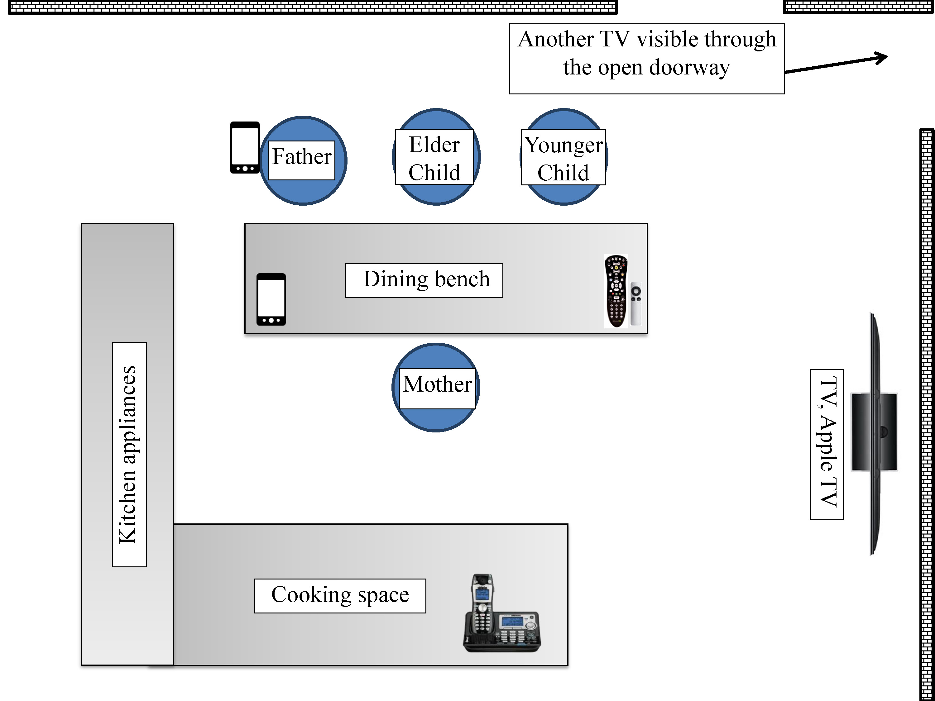
Understanding Technology Use At Mealtimes
Notes:
Intermittent use
Personal technologies for shared causes
Technology remain at the background – no one is looking at it all the time. This is NECESSARY. If requires CONSTANT ATTENTION, it is not allowed.
Provokes conversation and support conversation – people relate the media with their own memory, uses technology to support the ongoing need and conversation

Slide 18
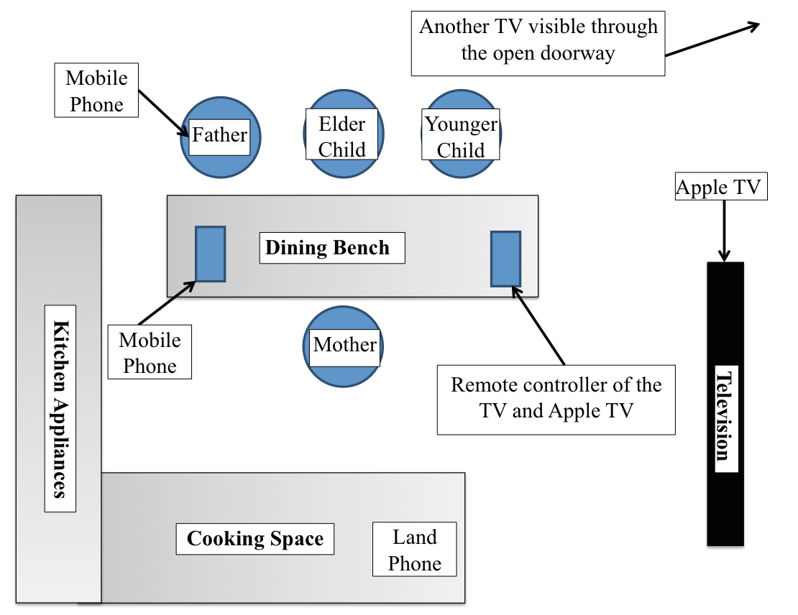
Spatial Arrangement
Technologies orientate to people
Hidden technology
People orientate to technology
Displaced technology

Slide 19
Mutual Shaping of Technology and Commensality
Technology and mealtime conversations
  Provoke Conversation
      “Sometimes, [name of a child] gets off the car and runs behind it while we go down that slope in front of our house. We were laughing because a man in that TV was running after the car just like her.” (Mother, family 1)
  Support Conversation
      “Someone mentions like, perhaps a new restaurant that has opened, what’s the other people say about it? As I am telling it in a dinner party conversation, so we need to quickly check a blog and then everyone will see what they can find about it..” (Mother, family 2)

Slide 20
Mutual Shaping of Technology and Commensality
Attention towards the technology
    “And those kids. You can talk to them and there is just no response because they are just concentrating on that (Phone)” (Father, family 1)
    “They don’t hear” (Mother, family 1)
    “You gotta yell, GIRLS.” (Father, family 1)
  -----
  “We try to watch those serials or those movies which do not require much attention. Otherwise we keep watching it and forget to eat. Some comedy series are seen out of order too.” (Wife, family 4)

Slide 21
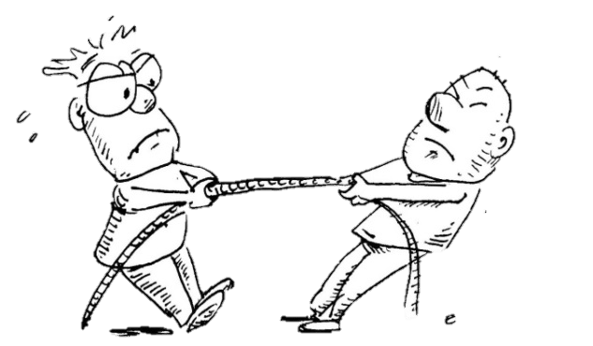
Mutual Shaping of Technology and Commensality
Balancing togetherness and technology consumption
  “Tug of war” in Family two
  “If we are speaking (to them) and they are ignoring us, and the TV gets priority over people, that is not on. So that’s when we would stop the TV or reprimand the children, or both.” (Father, family 6)

Slide 23
Notes:
Positives/negatives
Personal Devices available, but creates tension
Backgrounded nature

Slide 24
Technology Usage at Mealtimes
Good Intention
Identify existing human forces
Discernment
Amplify the right human force
Self Control
Avoid indiscriminate dissemination

Slide 25
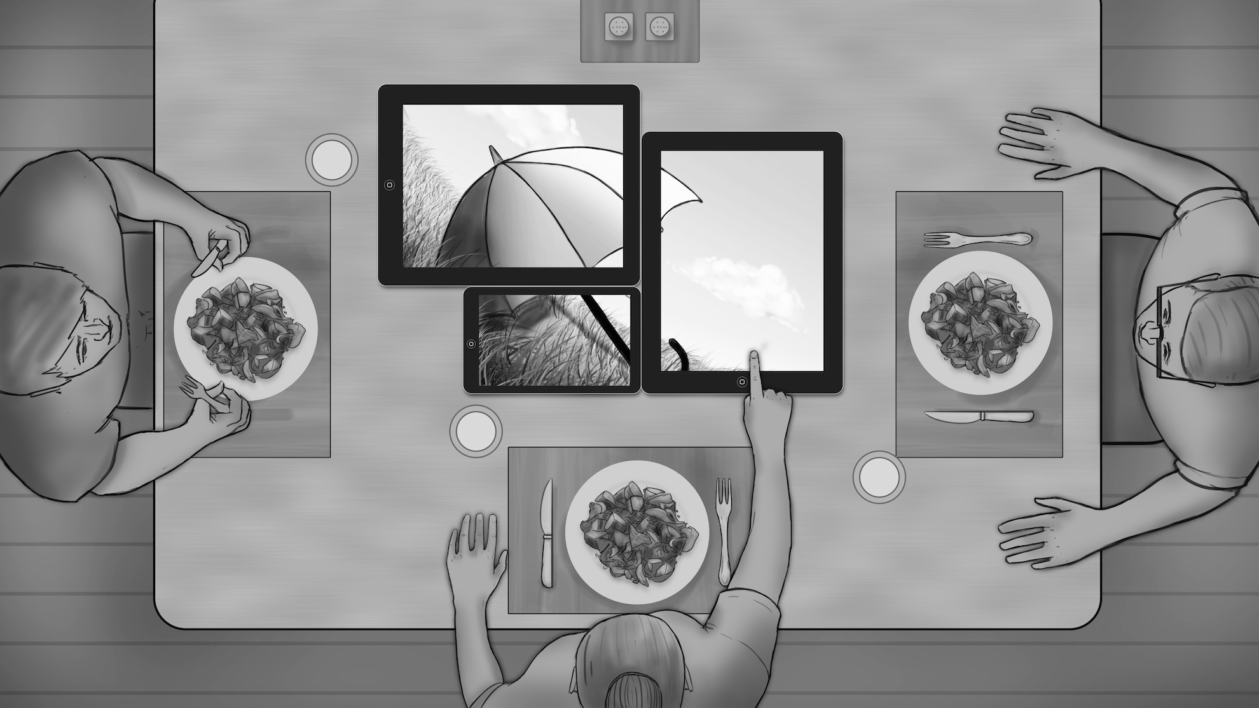
Notes:
Convert personal devices into shared resource
Rationale: 1. Transform the personal into the social
2. Use the data avaialble

Slide 26
Sharing Technology and Life at Family Mealtimes
Notes:
Convert personal devices into shared resource

Slide 27
Chorus
Thursday 14:50, Room 302

