Slide 1
Social Media Question Asking (SMQA): Whom Do We Tag and Why?
Hasan Shahid Ferdous
^{Research Fellow}
Microsoft Research Centre for Social NUI
School of Computing and Information Systems
^{The University of Melbourne}
OzCHI 2018, Melbourne

Slide 2
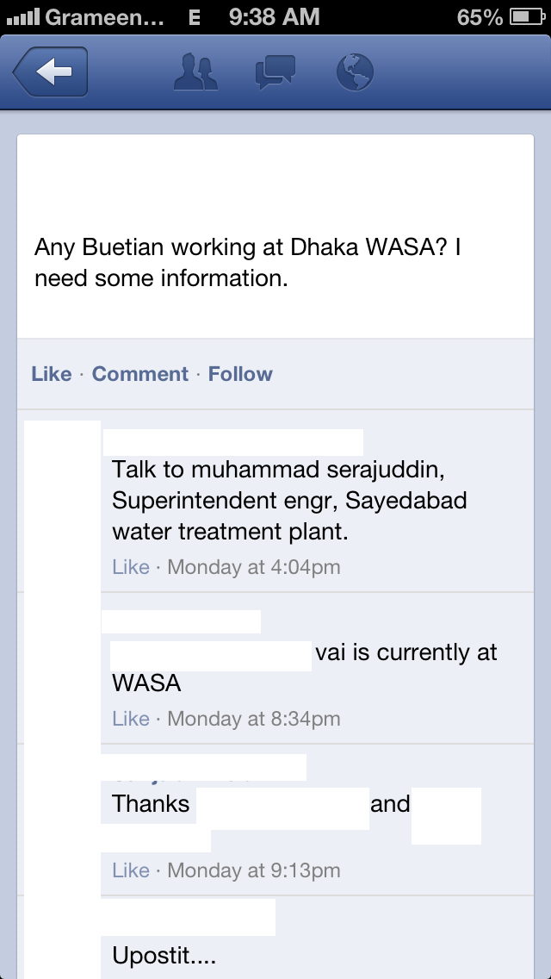
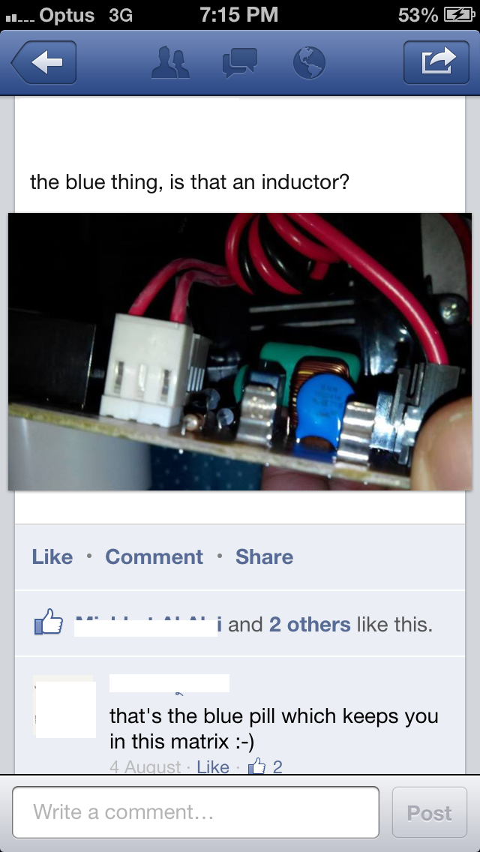
Social Media Question Asking (SMQA)
Questions asked through social media
  Factual,
  Subjective,
  Invitations,
  Seek favours, etc.
Different from Search Engines …
Different from Crowd-Sourced Systems …
Different from Asking Specific Friends …

Slide 3
Target Audience of the Queries in Social Networking Sites
SNSs decides appropriate audience
Possibly does for all posts
No control from users
SNSs allows tagging
Enable users to tag specific friends
Remaining open to answers from others

Slide 4
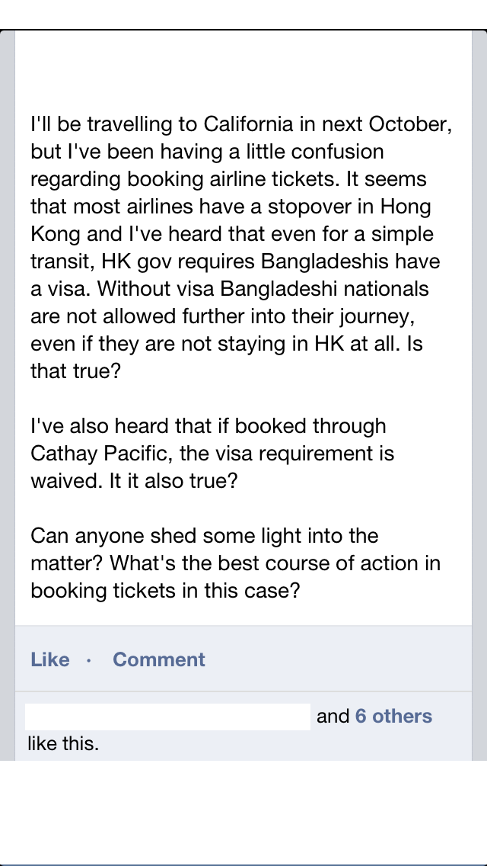
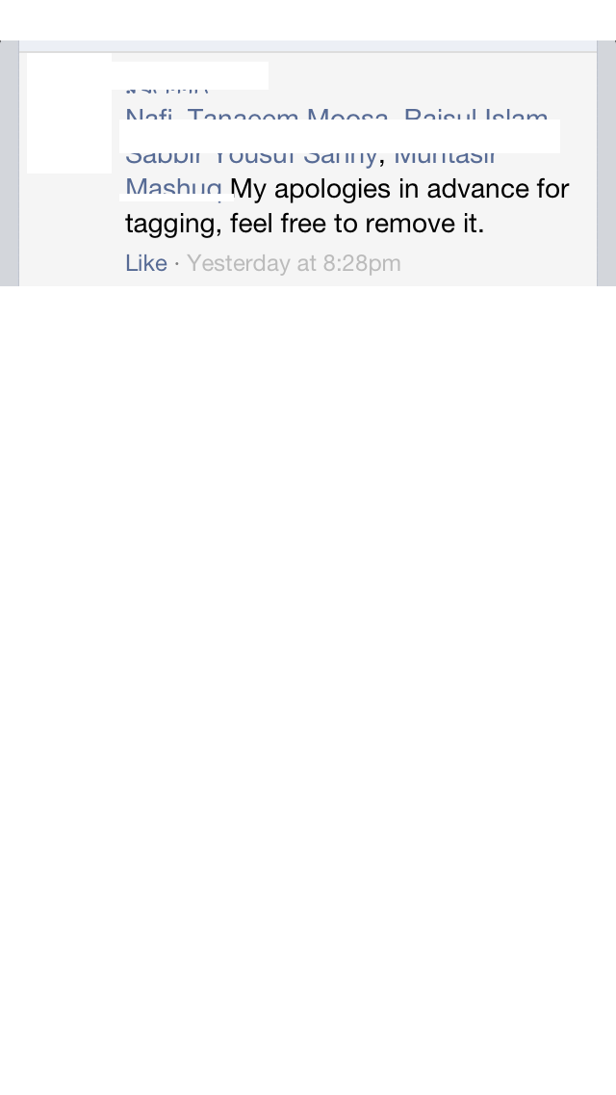
Tagging Specific Users in SMQA
Benefits of Tagging Specific Users in SMQA
  Quicker Response
  Better Response Rate
  More Meaningful Response
Algorithmically Generated Tagging in SMQA
  Common interests, profiles to determine expertise (Social Butterfly: Hecht et al. 2012)
  Social Q/A for professional queries forwarded to experts (IM-an-Expert: White et al. 2011)

Slide 5
Outline of the Research
Targeted queries on Social Networking Sites (SNSs)
Tags some of friends in the post
Remains open to others
Two-phase study on Topic and Type
Rationale behind tagging (Whom? Why?)
Outcomes of tagging
Outcomes
Contradicts with existing works
Identifies design opportunities

Slide 6
Study Design and Data Collection: Phase 1
Reached 20,000 students and alumni through university mailing list
  One email per week for 4 weeks
  Requested a sample of any question they posted over the past one month period
  991 unique responses received from users, senders anonymized the samples
Categorized into types and topics suggested by Morris et al. [2010]
  Tagging activities with topics and types

Slide 7
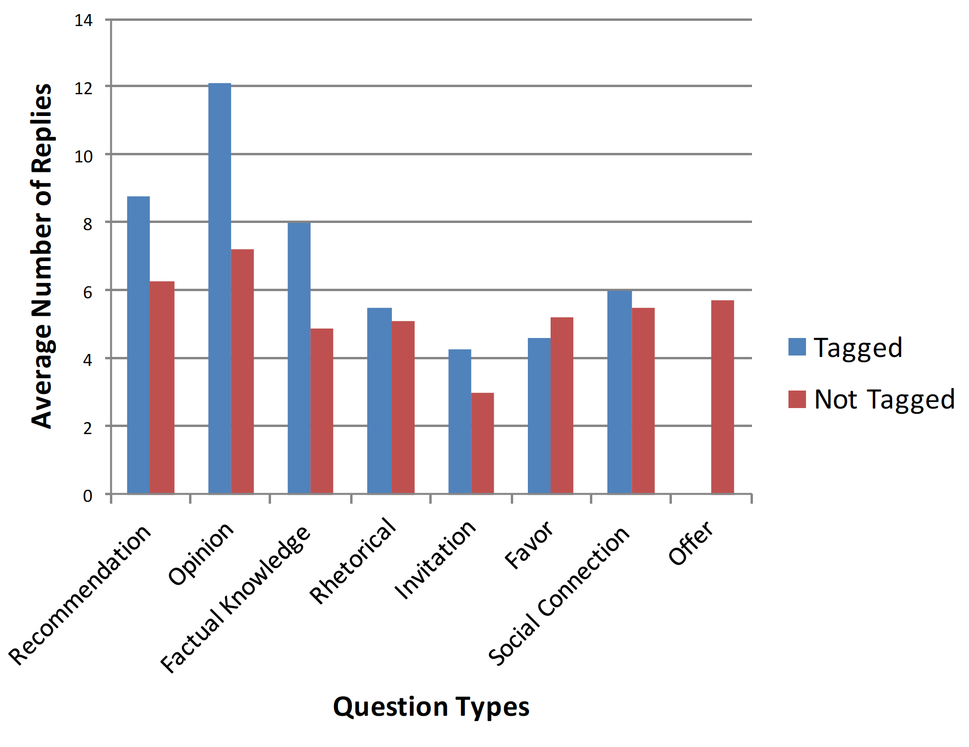
Analysis of Tagging Behavior: Phase 1
13.5% of questions were tagged
1.9 persons tagged per (tagged) question
31% status had privacy settings as “Public”
No significant variation in male and female users’ tagging behaviors
  Females vs Males: 6.5% vs 6% of total questions

Slide 8
Analysis of Tagging Behavior: Phase 1 (Cont.)
Consideration | Tagged queries | Untagged queries
Received at least one reply Average replies Response from all tagged person(s) in tagged queries Response from untagged person(s) in tagged queries Average number of untagged users’ responses Response time for first response | 98% 6.3 52% 93% 3.05 11 minutes | 87% 4.9 N/A N/A 3.2 16 minutes

Slide 9
Analysis of Tagging Behavior: Phase 1 (Cont.)
Question Type | No. of Queries | No. of Tagged Queries | % of Tagging
Recommendation Opinion Factual Rhetorical Invitation Favor Social connection Offer | 69 198 249 120 29 178 129 19 | 4 10 19 1 19 42 39 0 | 5.8 5.0 7.6 0.8 65.5 23.6 30.2 0
Question Topic | No. of Queries | No. of Tagged Queries | % of Tagging
Technology Entertainment Home & Family Professional Places Restaurants Current events Shopping Ethics & Philosophy Miscellaneous | 238 235 127 107 50 11 105 19 60 39 | 31 10 16 14 19 5 21 9 6 1 | 13 4.3 12.6 13.1 38 45.5 20 47.4 10 2.56

Slide 10
Statistical Analysis of Data: Phase 1
Statistically significant difference between the average numbers of replies for tagged and untagged questions.
Number of replies (both tagged or not tagged) depends on question type and topic.
Does not show for which types/topics there is a significant difference in the number of replies, people’s rationale behind these differences.

Slide 11
Controlled Experiment on Tagging Behavior (Phase 2)
Request for volunteers
10 participants (6 males, 4 females) from two different universities
All participants had at least 150 friends on Facebook, including common friends
  Around 2,000 unique users in total in all participants’ friend-lists
Provided a set of examples of questions containing one example from each type/topic
Participants were asked to post questions on their Facebook, and tag users (if appropriate)
Monitored the participants for one-month period.
Semi-structured interviews with participants.

Slide 12
Tagging Preference for Various Types/Topics
Question Type | No. of Queries | No. of Tagged Queries | % of Tagging
Recommendation Opinion Factual Rhetorical Invitation Favor Social connection Offer | 17 13 28 11 9 7 14 7 | 2 1 14 0 4 1 6 1 | 11.8 7.7 50 0 44.4 14.3 42.9 14.3
Question Topic | No. of Queries | No. of Tagged Queries | % of Tagging
Technology Entertainment Home & Family Professional Places Restaurants Current events Shopping Ethics & Philosophy | 28 7 9 6 5 15 19 9 8 | 10 0 1 1 2 5 6 4 0 | 35.7 0 11.1 16.7 40 33.3 31.6 44.4 0

Slide 13
Analysis of Tagging Behavior: Phase 2
Average number of users tagged:
  Factual knowledge: 1.8
  Invitation: 2.9
  Social connection: 2.05
Did not want to tag:
  Type: rhetorical, opinions
  Topic: ethics & philosophy, entertainment, home & family
Interview focusing on:
  what users considered
  how they choose whom to tag

Slide 14
Rationale for Tagging: Relationship vs Expertise
Expertise on that topic-area is not a significant factor in tagging people (except specific cases)
Same person is tagged multiple times for different types and topics of questions
  Relation gets higher priority than expertise
  “He is my best friend. I gossip with him, share my problems and moments of glory with him. Every day we pass a lot of time together at the University and outside. So, whenever I am facing a query, I do remember him. It is not that I think he has the best knowledge on that, but he is the first person I can think of.”

Slide 15
Relationship vs Expertise (contd.)
When relationship or expertise is preferred?
  Relationship: favor or social connection
  “I have more than 600 friends in my Facebook profile. I do not know each of them personally. There are people from my class, friends of friends, etc. There are people that I have never meet, distant family members, every kind of. Though I appreciate reaching the right person for my queries if it is only an information, but I do not feel good about asking a favor of someone I do not know personally.” (P9)
  Openness to voluntary help from others
  Factual knowledge: Opposite was observed from their behavior during 2nd phase study

Slide 16
Rationale for Tagging: Temporal, Spatial and Other Factors
Geographic preferences if the query depends on local information
“I chose him because he has recently visited [removed]. So, he must have current information about accommodation and local details.”
Temporal factors: Time zone, working hours, personal habits
“Tagging a friend is like sending an SMS, their phone will likely issue an alert. I will never tag a friend if I know they are at work or are asleep… as more and more of my friend are living abroad, I always check the time in their locality before I make any contact.”
Privacy, Politics, Religion Gender Issues, etc.
“I wanted to tag [name] in this question, in fact I did, but later removed the tag. My other friends will think that I am treating this one friend specially.”

Slide 17
Discussion
Tagging has a statistically significant impacts the amount of attention a post receives
  Metric: number of replies
Presence of tags, number of tags:
  Types/Topics:
    Invitation, factual/favor, social connection, technology/restaurant, places, shopping got tagging.
    Rhetorical questions, opinion, ethics, entertainment, offer received least tagging
  Factual knowledge-based questions:
    Less in real-life data than in controlled experiment
Strength of social ties over expertise

Slide 18
Design Implications
Avoid False Positives
  Outrage in case of inappropriate/irrelevant tagging (Hecht et al.)
  Users of SMQA usually show patience (Morris et al. and our data)
    Tagging users by small groups (White et al.)
Combination of Expertise and Relation
Privacy and Tagging
  Making implicit assumptions about their relationship due to tagging
  Suggest a list of potential people to tag
Spatial and Temporal Considerations
  Urgency
  Geo-locations

Slide 19
Social Media Question Asking (SMQA): Whom Do We Tag and Why?
Hasan Shahid Ferdous
Email: hasan.ferdous@unimelb.edu.au
^{Website: www.hsferdous.net}

Slide 20
References
Brent Hecht, Jaime Teevan, Meredith Ringel Morris and Dan Liebling. 2012. SearchBuddies: Bringing Search Engines into the Conversation.
Ryen W. White, Matthew Richardson and Yandong Liu. 2011. Effects of community size and contact rate in synchronous social qa. Proceedings of the SIGCHI Conference on Human Factors in Computing Systems, ACM, Vancouver, BC, Canada, 2837-2846.
Jaime Teevan, Meredith Ringel Morris and Katrina Panovich. 2011. Factors Affecting Response Quantity, Quality, and Speed for Questions Asked Via Social Network Status Messages. In ICWSM
Jaime Teevan, Daniel Ramage and Merredith Ringel Morris. 2011. # TwitterSearch: a comparison of microblog search and web search. in Proceedings of the fourth ACM international conference on Web search and data mining, ACM, 35-44.
Emilee Rader and Rebecca Gray. 2015. Understanding user beliefs about algorithmic curation in the Facebook news feed. In Proceedings of the 33rd annual ACM conference on human factors in computing systems, ACM, 173-182.

Slide 21
References (contd.)
Meredith Ringel Morris, Jaime Teevan and Katrina Panovich. 2010. A Comparison of Information Seeking Using Search Engines and Social Networks. ICWSM, 10. 23-26.
Katrina Panovich, Rob Miller and David Karger. 2012. Tie strength in question & answer on social network sites. In Proceedings of the ACM 2012 conference on computer supported cooperative work, ACM, 1057-1066.
Meredith Ringel Morris, Jaime Teevan and Katrina Panovich. 2010. What do people ask their social networks, and why?: a survey study of status message q&#38;a behavior Proceedings of the SIGCHI Conference on Human Factors in Computing Systems, ACM, Atlanta, Georgia, USA, 1739-1748.
Cliff Lampe, Nicole B Ellison and Charles Steinfield. 2008. Changes in use and perception of Facebook. in Proceedings of the 2008 ACM conference on Computer supported cooperative work, ACM, 721-730.
Cliff Lampe, Jessica Vitak, Rebecca Gray and Nicole Ellison. 2012. Perceptions of facebook's value as an information source. in Proceedings of the SIGCHI conference on human factors in computing systems, ACM, 3195-3204
Jin-Woo Jeong, Meredith Ringel Morris, Jaime Teevan and Dan Liebling. 2013. A Crowd-Powered Socially Embedded Search Engine.

Slide 22
References (contd.)
Damon Horowitz and Sepandar D Kamvar. 2010. The anatomy of a large-scale social search engine. in Proceedings of the 19th international conference on World wide web, ACM, 431-440.
Motahhare Eslami, Aimee Rickman, Kristen Vaccaro, Amirhossein Aleyasen, Andy Vuong, Karrie Karahalios, Kevin Hamilton and Christian Sandvig. 2015. I always assumed that I wasn't really that close to [her]: Reasoning about Invisible Algorithms in News Feeds. in Proceedings of the 33rd annual ACM conference on human factors in computing systems, ACM, 153-162
Saif Ahmed, Md Tanvir Alam Anik, Mashrura Tasnim and Hasan Shahid Ferdous. 2013. Statistical analysis and implications of SNS search in under-developed countries. in Proceedings of the 25th Australian Computer-Human Interaction Conference:Augmentation, Application, Innovation, Collaboration, ACM, 487-496
Hasan Shahid Ferdous, Mashrura Tasnim, Saif Ahmed and Md Tanvir Alam Anik. 2015. Social Media Question Asking: A Developing Country Perspective. in Recommendation and Search in Social Networks, Springer, 189-216

